Slide 1

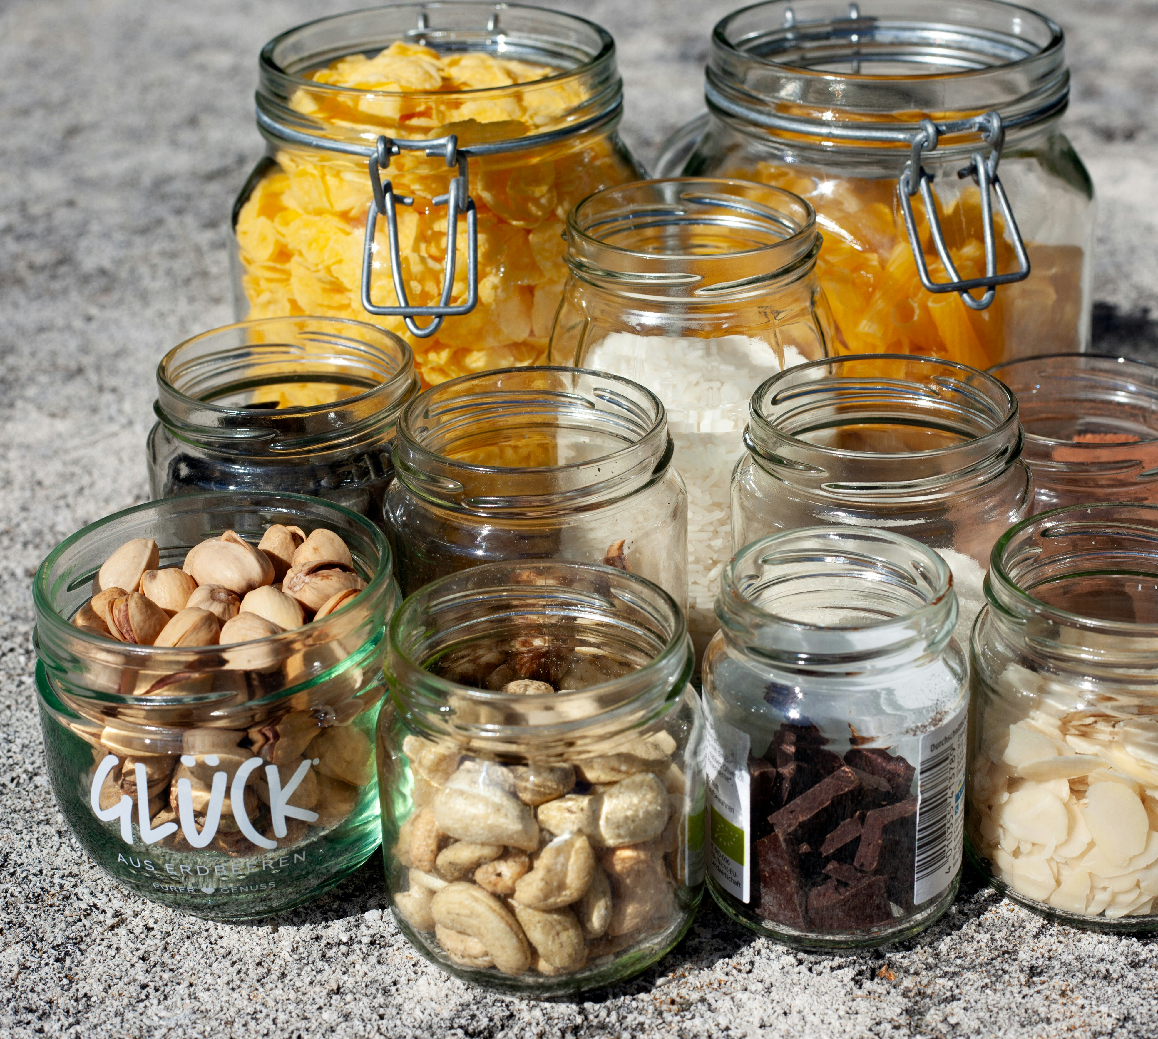




SEASONAL TIP OF THE WEEK
Swap disposables for reusables
What?
The world produces over 1 million plastic bottles per minute, and many end up in landfills or the ocean. Small swaps = big impact!
How?
Ditch plastic straws, cups & cutlery.
Use cloth napkins instead of paper ones.
Bring a reusable water bottle & coffee cup
Use what you have already before buying reusable products
For more tips on sustainable living, resources, community and much more, then join us….
Notes:
Due to our actions, many animals and plants are now struggling to survive. In fact, global species populations have declined by almost 70% over the past 50 years. This is due to 3 main factors, which we will explore now.

Slide 2
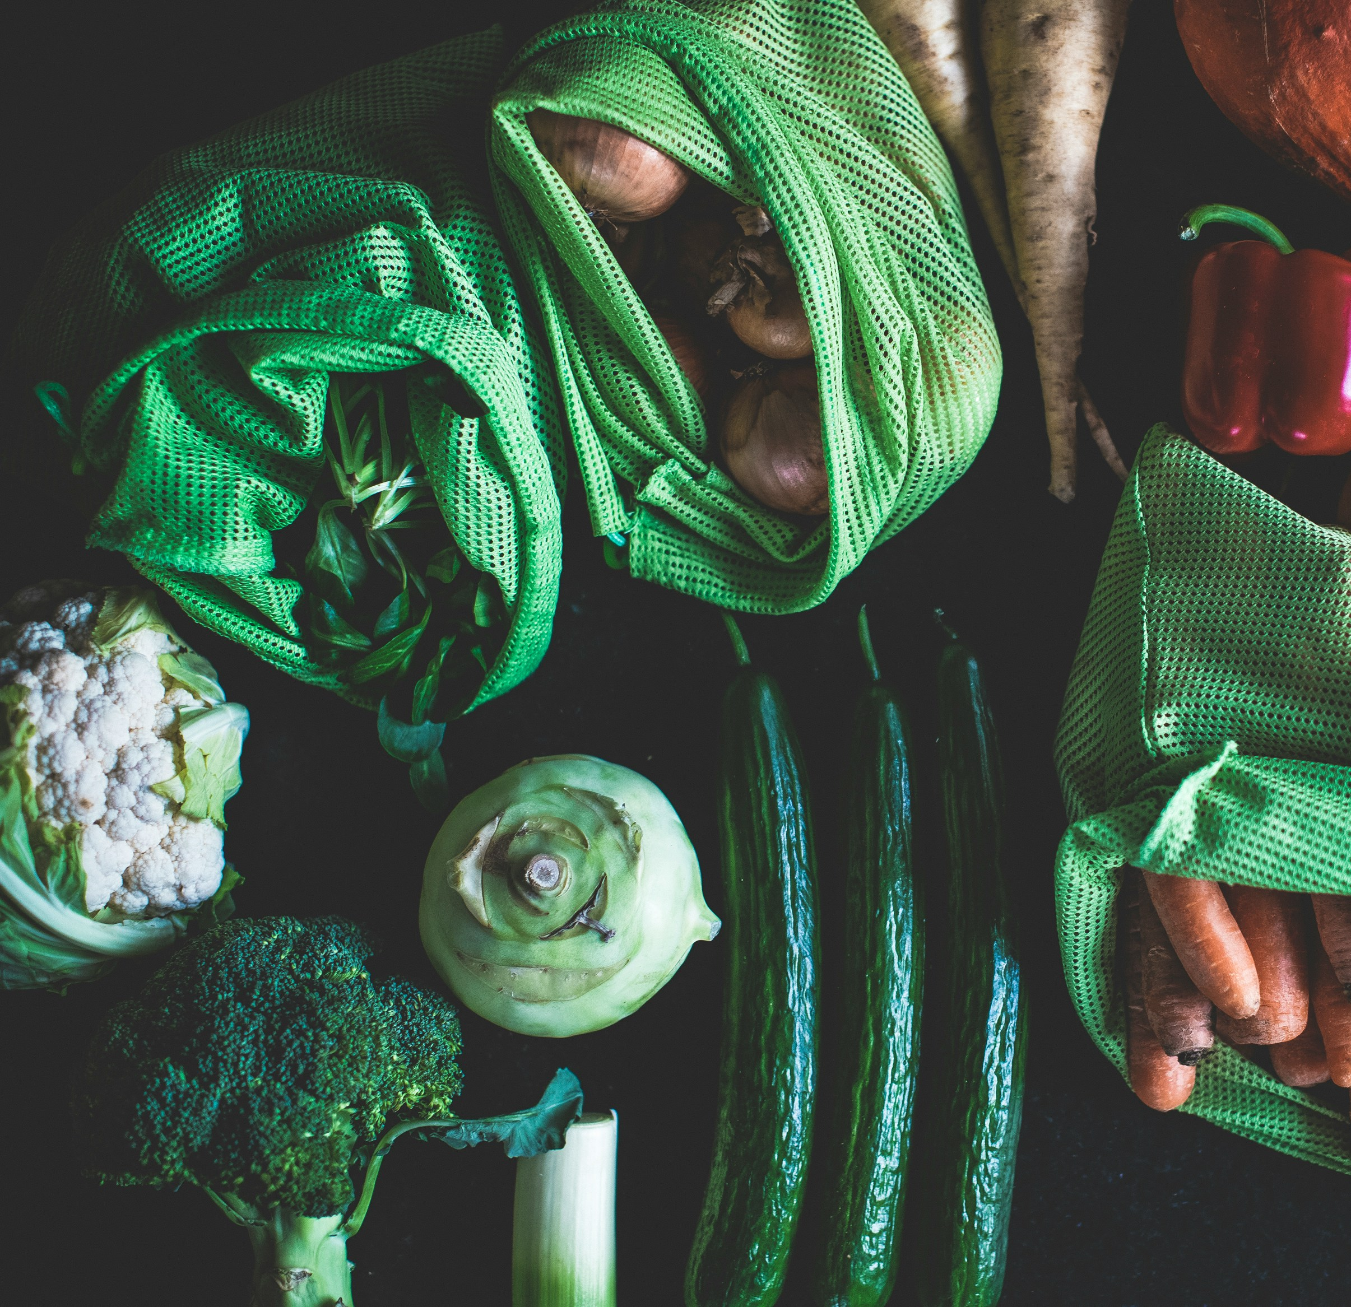
SEASONAL TIP OF THE WEEK
Buy in bulk and avoid packaging
What?
Packaging waste makes up over 40% of global plastic waste. Shopping smart reduces waste at the source!
How?
Choose seasonal and loose fruit and veg
Bring your own containers to refill shops or restaurants if you need to take away food
Choose products with minimal and compostable packaging
Carry tupperware and tote bags for any eco shopping
For more tips on sustainable living, resources, community and much more, then join us….
Notes:
Due to our actions, many animals and plants are now struggling to survive. In fact, global species populations have declined by almost 70% over the past 50 years. This is due to 3 main factors, which we will explore now.

Slide 3
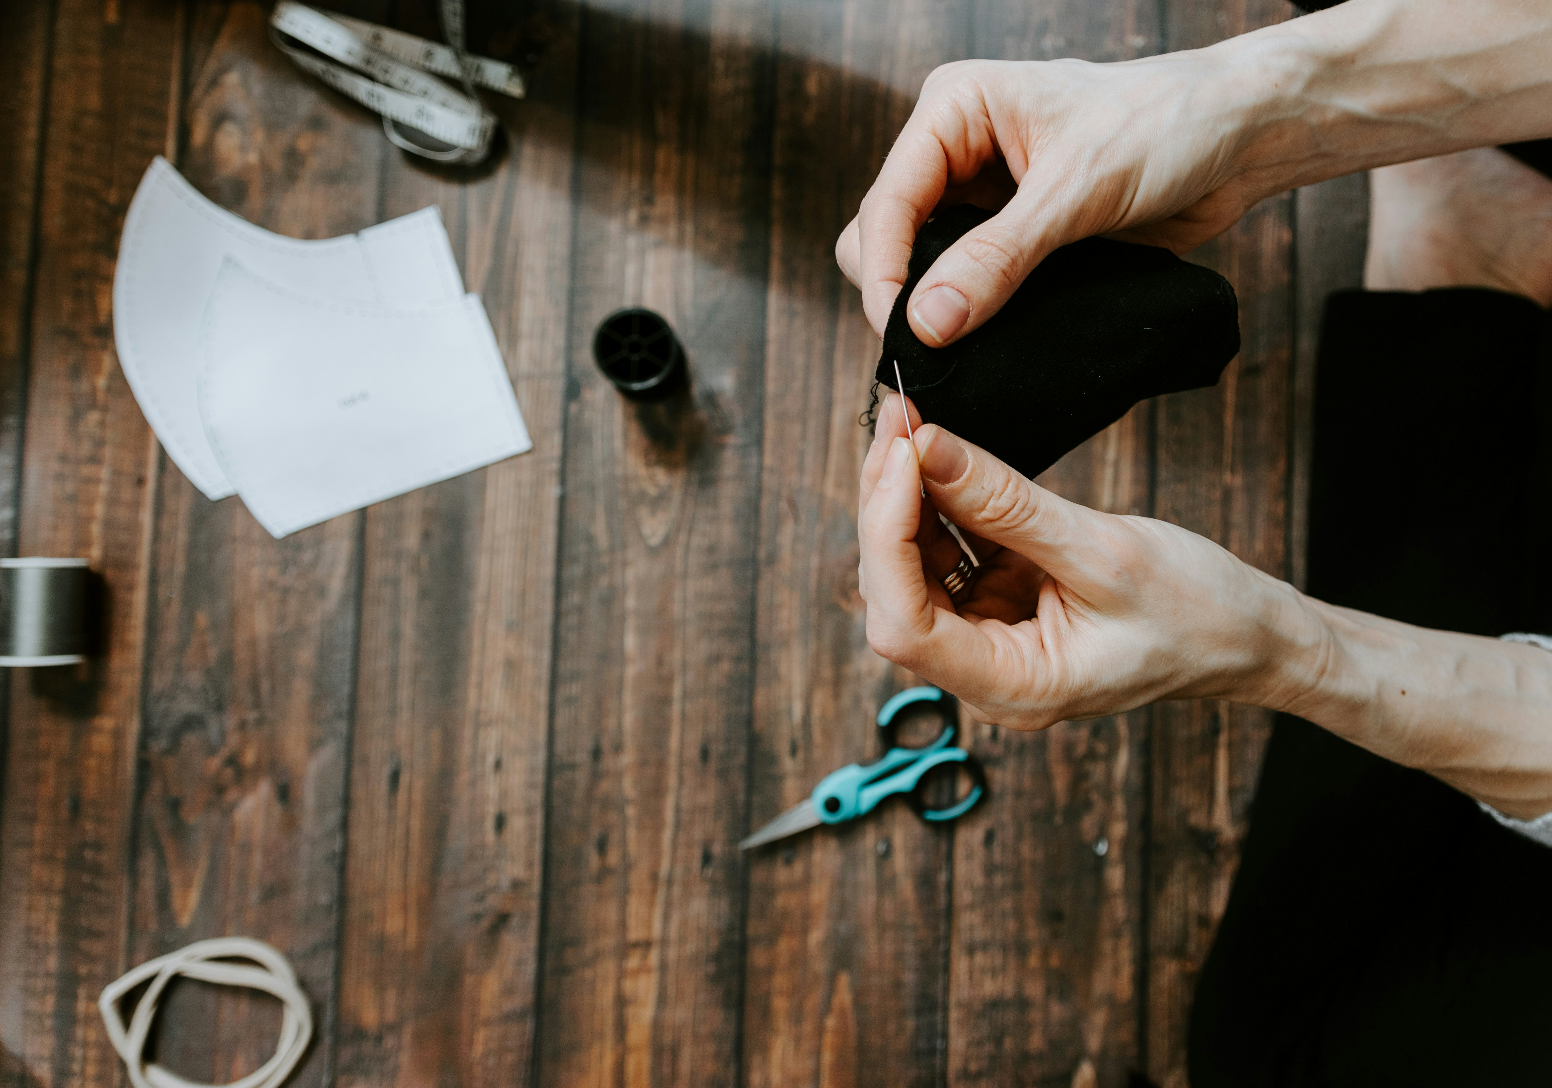
SEASONAL TIP OF THE DAY
EMBRACE THE 5 R's
What?
We generate over 2 billion tonnes of waste yearly, with 400 million tonnes of plastic. Most isn’t disposed of safely. The 5Rs help cut waste & protect the planet!
How?
Refuse single-use plastics & excess packaging. Reduce waste by choosing quality over quantity.
Reuse by repairing, upcycling & refilling.
Recycle properly to avoid contamination.
Rot food scraps through composting.
Carry a reusable water bottle, coffee cup & tote bag – small swaps make a big difference!
For more tips on sustainable living, resources, community and much more, then join us….
Notes:
Due to our actions, many animals and plants are now struggling to survive. In fact, global species populations have declined by almost 70% over the past 50 years. This is due to 3 main factors, which we will explore now.

Slide 4

SEASONAL TIP OF THE DAY
LOVE YOUR LEFTOVERS
What?
One-third of all food is wasted globally, while up to 10% of emissions come from food waste. Let’s stop waste before it starts!
How?
Store food properly to keep it fresh.
Get creative with scraps – make soups, stocks, smoothies & stir-fries!
Compost what you can’t eat.
Plan meals & freeze extras to cut down on waste!
For more tips on sustainable living, resources, community and much more, then join us….
Notes:
Due to our actions, many animals and plants are now struggling to survive. In fact, global species populations have declined by almost 70% over the past 50 years. This is due to 3 main factors, which we will explore now.

