Slide 1
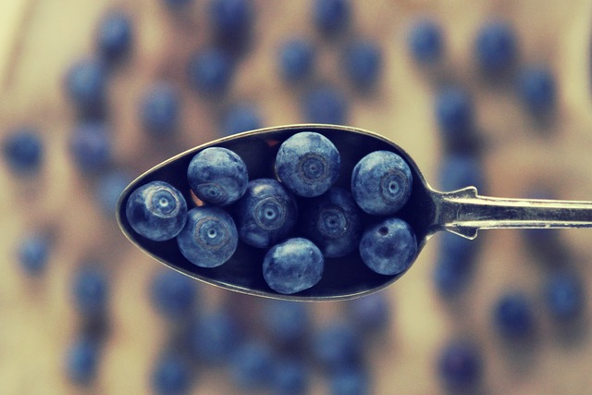
Key theme presentations
Food For Thought
Notes:
Another Way is a charity that aims to connect passionate individuals who want to make positive lifestyle changes to create a healthier planet. Another Way does this by providing resources, guidance and connections through their platform, Power of Ten, in the hope that individuals will be inspired to take the information into their wider communities to influence change and start conversations around sustainable lifestyles. This is the Slide Deck that accompanies their Food For Thought Pack, which aims to inform about the problems with our food systems, the solutions that are already in place and the actions that can be taken to catalyse change.
This pack is complimented by accompanying resources based around equipping the reader with facts and solutions to help them make informed consumer choices that are compatible with their lifestyle.
Throughout the slides we provide an insight into the interconnectivity of all the planet’s delicate relationships, demonstrating that one change can have a knock-on effect on others, and that our overall aim should be to restore nature's symbiotic relationships, that have been disrupted by humans.

Slide 2


Power of ten mission
If 1 person tells 10 people and those ten people tell 10 more… within 10 days the whole world will have been inspired
Notes:
The Power of Ten is a platform set up for young environmentalists that follows the mantra: @
‘If 1 person tells 10 people and those ten people tell 10 more, within 10 days the whole world will have been inspired.’
Taking this mantra, we hope to spread positive messages about what can be done if we all make small changes to help our planet.
The Power of Ten Slide Decks aim to give an insight into the main issues facing our environment. Instead of focusing on the problems, the slides provide inspirational action that you can take into your lives to make positive changes for you and the planet. The aim is that you then go on to inspire others to make similar changes, so that the positive messages are continuously spread through a cascade effect.

Slide 3
Overview
Food for Thought
Industrial Farming : The Problems and Solutions
Fruits And Vegetables : Shipping Fruit and Seasonal Fruit
Palm Oil : How to be a Conscious Consumer
Notes:
In this Slide Deck, we will discuss the main issues with our current food industry. First, we will discuss the problems of the farming industry, and propose quick changes that you can make in your own lives. Next, we will look at fruit and vegetables, discussing the transportation of goods and the importance of eating seasonal produce. Lastly, we will talk about palm oil, one of the largest environmental problems that we can all help to reduce.

Slide 4
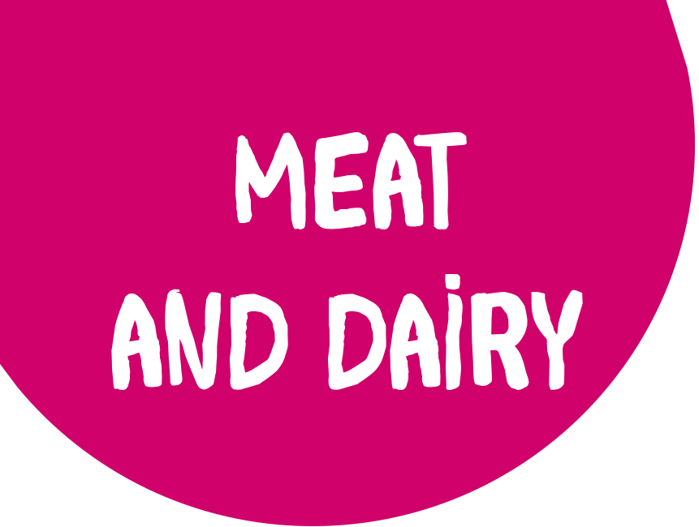
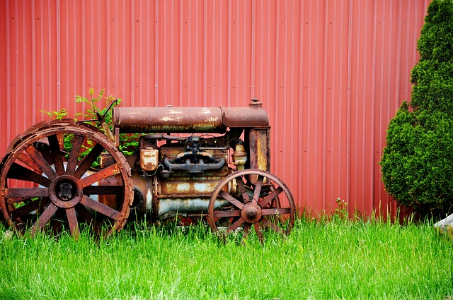
Industrial Farming : Intro
Notes:
Throughout humanity’s history, we have been consuming meat products. When done at a small scale, meat production doesn’t cause a significant issue for the environment. However, with the increasing population, the demand for meat products has grown to an unsustainable level. Let’s look at some of the problems with our modern-day practices.

Slide 5
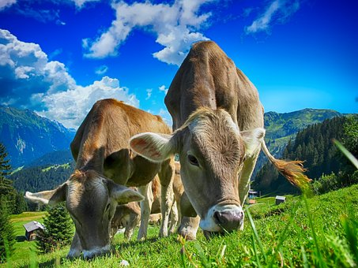
Industrial Farming : Beef
Only 3.2% of UK cattle market
Notes:
When you think of cow farming, what image is conjured up in your head? The cattle- farming industry would love you think of an image like this: In fact, organic farming, where cows are fed with grass, makes up only 3.2% of beef production in the UK today.

Slide 6
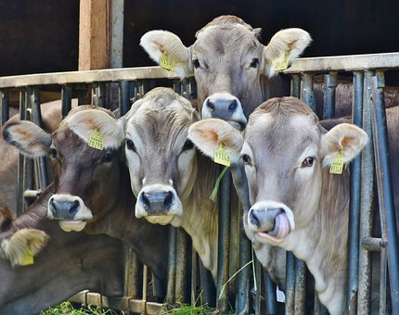
Industrial farming : Beef
Over 98% of global agriculture is non-organic
Cattle are crammed into large pens
Fed processed pellets made from grains,
maize, soy and cereals.
Notes:
Globally, non-organic farming makes up over 98% of the current beef market, with cows crammed into pens like these. Q: But what do you think the problem is with farming like this, in relation to our climate? (Ask audience)
When animals are crammed into pens like this, they cannot be fed on freshly grown grass. Instead, these animals are fed manufactured feed specifically grown for the cattle industry - generally a mixture of soya, seed and grains. This means that more land is needed to grow feed on, to then feed the cows that also need land to live on, to finally then feed us. So, how much land do we need per person? Let’s look at an image which breaks that down.

Slide 7
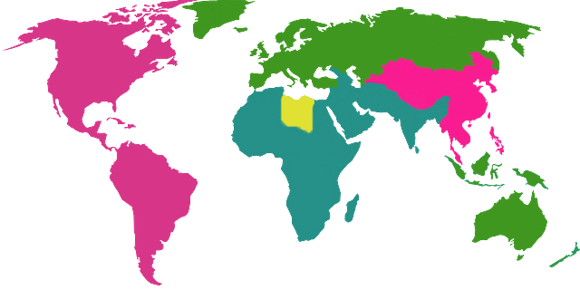
Industrial farming : Land use
Other
Includes 19% barren
10% glaciers
8% shrub land
1% fresh water
Livestock 27%
Meat, dairy, grazing and feed crops
Forests 26%
Crop land 7%
Crops used for human consumption
Built up area 1%
Human settlements and infrastructure
Notes:
This map shows the land use of the entire world. You can see that land for livestock takes up 29% of all usable land - this is more land than forests cover, more land than what is barren, and with human settlements only making up 1% of land use, livestock use significantly more land than our houses and cities! There are several other reasons that cattle farming is so damaging - let’s look at these.

Slide 8

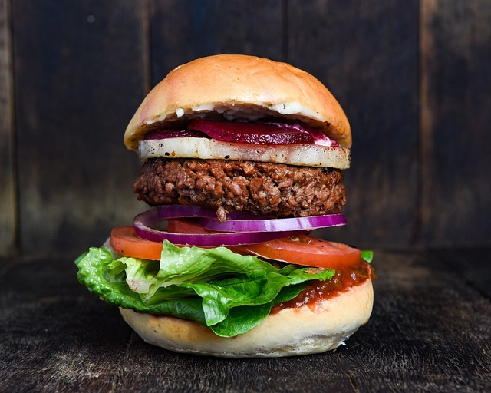
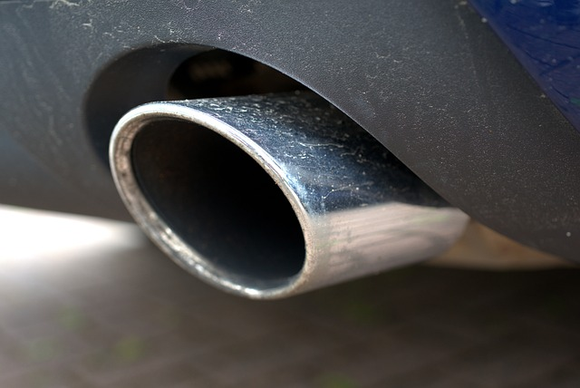
√
Impact of a Beef Burger
=
1 beef burger
48 miles of driving
WHY?
Write down why you think a beef burger has a big environmental impact
Notes:
Let’s play a little game. 1 beef burger has the same carbon footprint as driving for 48 miles in an average car, but why? Work with your partner to list some reasons as to why your beef burger may have such a significant environmental impact.

Slide 9
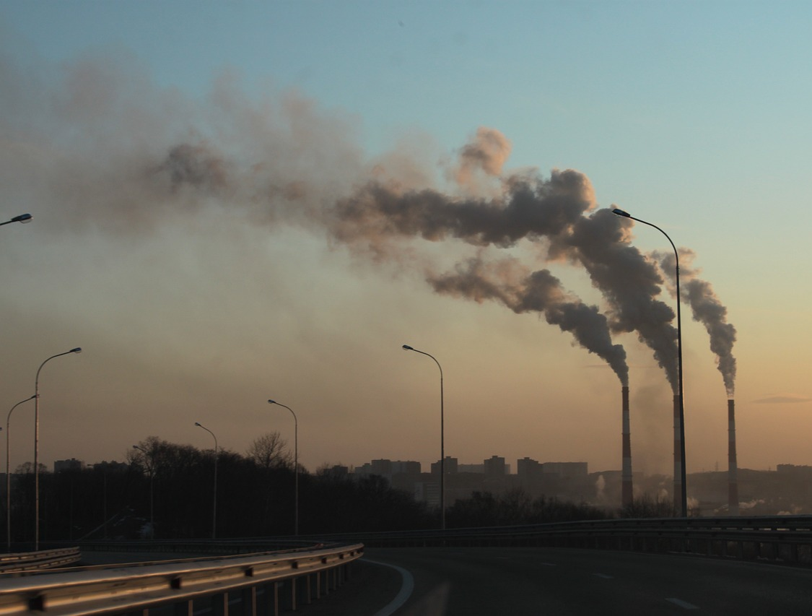
Impact of a Beef Burger
1 single beef burger has the same carbon emissions as driving 48 miles in a conventional car – why?
Land Use
Feeding – Production
Cow methane burps up to 45% of emissions
Farm energy use
Manure and Waste Management
Notes:
(Ask the audience what their reasons were)
As you may know, cow burps have a significant impact on our environment. In fact, the methane that cows belch out is 27x more potent than carbon dioxide. Methane emissions are what makes up most of a burger’s environmental impact. Other factors include land use, the production of cow feed, the energy used on the farm, and waste management. The energy from the storing and transportation of the burger also contributes, but to a smaller extent.
As we have discussed, cows need room to roam, but the driving force behind their land-related carbon emissions is the need for soy-based feed, which fuels deforestation in many places around the world, including Brazil.

Slide 10
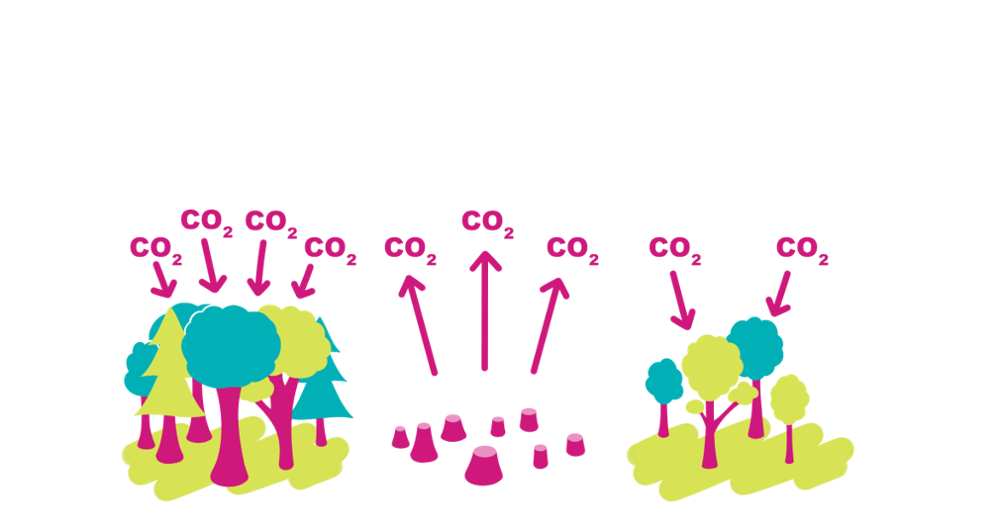
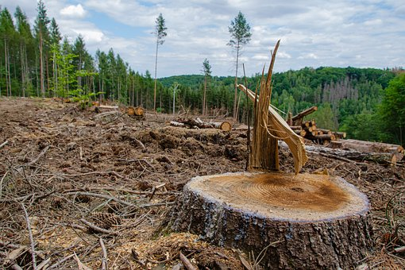
Industrial Farming : Deforestation
Meat production is biggest contributor​
Deforestation reduces the effectiveness of the forest carbon sink plus creates a carbon source
Split between feed and land for grazing
Notes:
To make space for all the cattle farms, we must use land that is already suitable for farming. Greater than this, however, is the need for suitable land to grow the soy that cattle feed is primarily made from.
Unfortunately, cattle farming often takes place in rainforest regions. Cattle farming is one of the primary drivers of deforestation across the world. As well as losing a valuable carbon sink when trees are cut down (a carbon sink is created when trees capture carbon dioxide from the air and store it), the trees also release their stored carbon into the atmosphere. Deforestation accounts for 13% of all global greenhouse gas emissions, more than all the cars in the world put together. Once a primary rainforest is destroyed, animals lose their habitats and species can be pushed closer to extinction

Slide 11
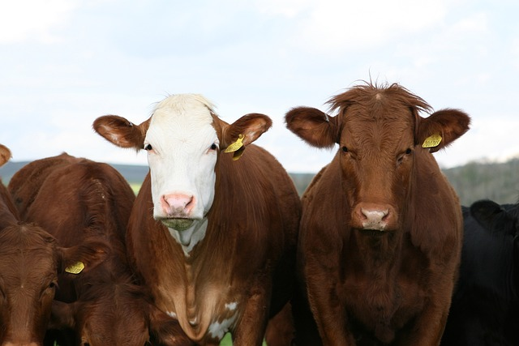
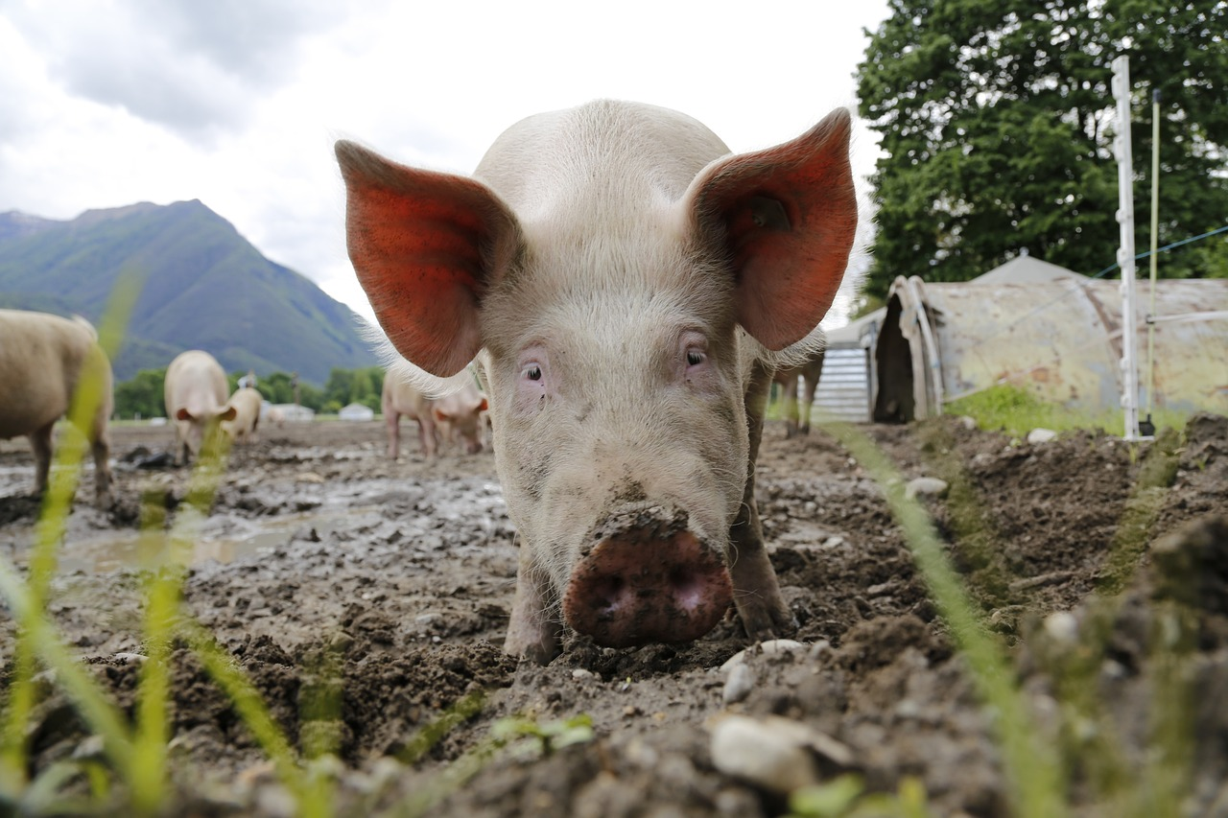
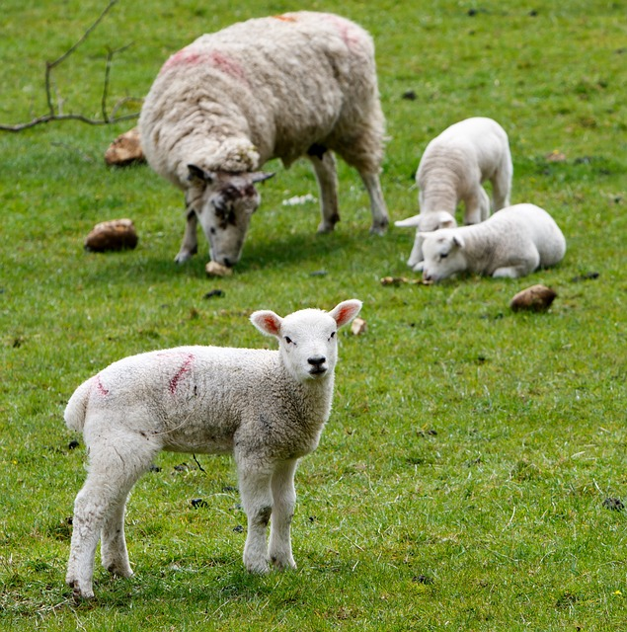
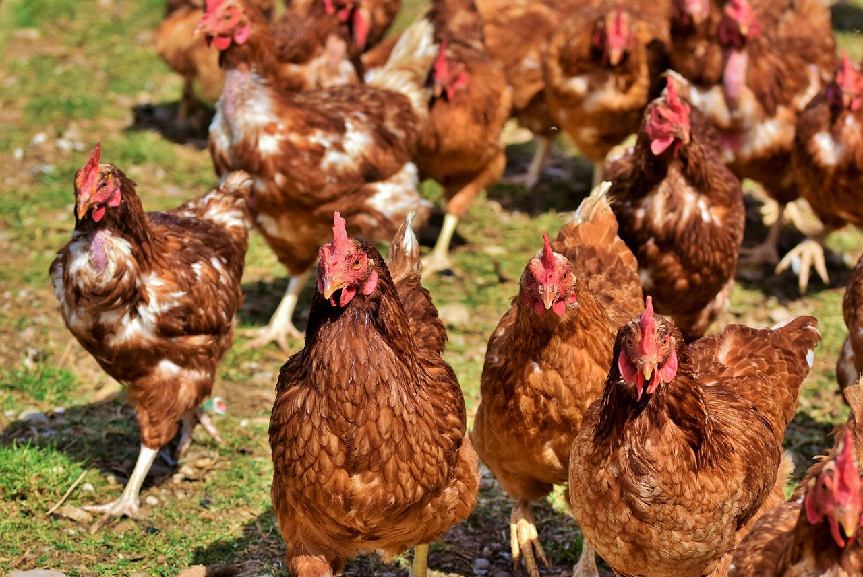
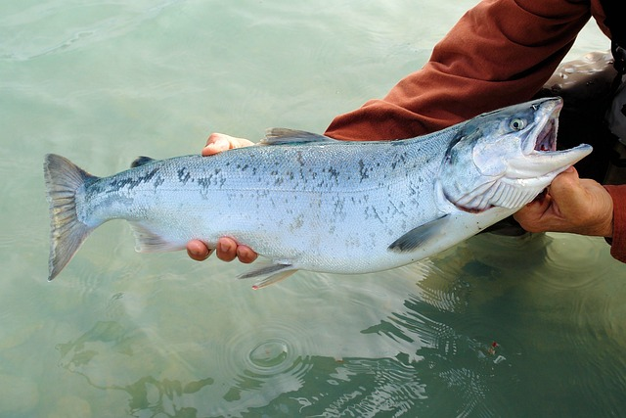
?
?
?
?
Hierarchy of meat eating
?
?
?
?
?
?
?
Notes:
Time for an activity! If eating beef is so bad, then what should we eat instead? It is not realistic for all the humans on earth to stop eating meat, so we have come up with a meat hierarchy to help you make informed choices about what you choose to eat instead of eating vegetarian all the time. Look at these pictures and rank them in order of their greenhouse gas emissions.

Slide 12
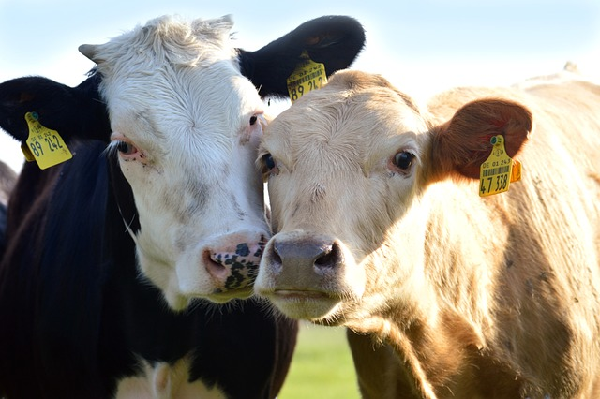
Hierarchy of Meat Eating
We don’t all have to give up meat,
we can just be more mindful of what we eat.
Meat Alternative
Chicken
Pork
Farmed Fish
Lamb
Beef
Notes:
Let's go through what we have discovered. Hopefully most of you have recognised that beef is the worst meat in the hierarchy. As beef is most damaging to the environment, we’ve put it put it at the bottom of our chart.
Next comes lamb and mutton. Sheep are also ruminants, meaning that they also belch out methane, and so they take up the next spot on the list.
What might surprise you is farmed fish. Fish farming practices use similar amounts of energy as land-based farming does. This also includes farmed crabs, lobsters and crustaceans. Next is pork, and then chicken. Finally, at the top are meat alternatives such as veggie burgers and meat free chicken and sausages.
At Power of Ten, we want to make sustainable choices accessible to all. If you find it difficult to cut meat out altogether then why not make an informed choice for your next meal? Choose a chicken burger over a beef burger or have pork instead of lamb.

Slide 13

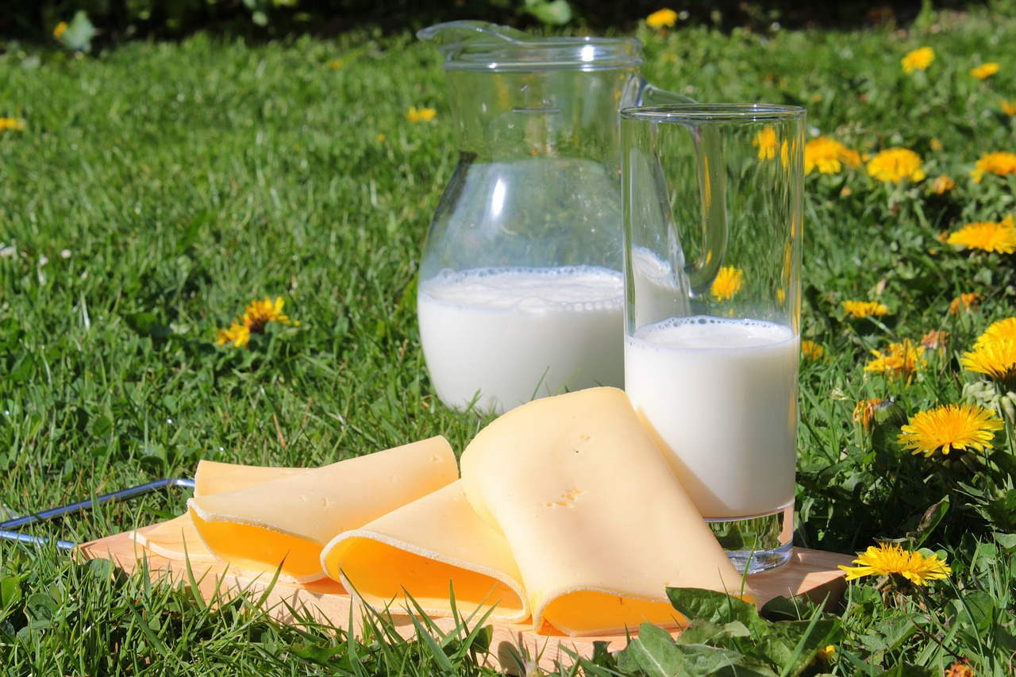
The Impact of Dairy
dairy
2 and a half pints per day of dairy milk has the same carbon footprint as a flight from London to New York
–––
Dairy milk has 2x the carbon footprint of plant-based milk
Notes:
Dairy farming is also carbon intensive. Just as the meat industry uses all that carbon to produce meat, we also need the energy from the cattle feed for cows to produce milk. The greatest proportion of dairy products’ carbon footprint comes from the dairy farm’s activities. If the cows eat feed made from soya, then deforestation for soya also has a significant impact on the industry's carbon emissions. In fact, if a family of 4 uses 2 and half pints of milk every day for 1 year, this would equate to the same carbon emissions as a flight from London to Hong Kong. By switching to plant-based milk, you could halve your carbon footprint.

Slide 14
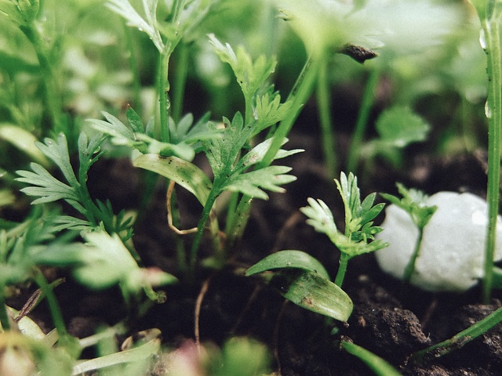
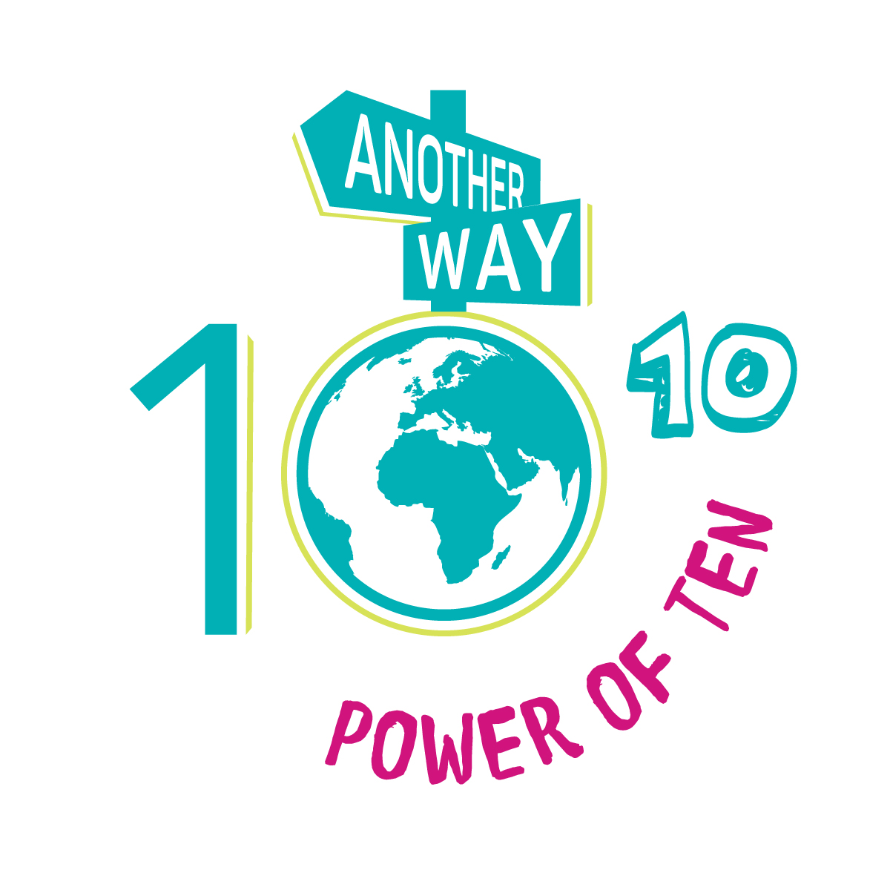
Solutions
Together We Can
fix our future
CONSUME : Be a conscious consumer
EDUCATE : Learn more about the topic
DO : Be Proactive. Get involved.
DISCUSS : Share knowledge with friends and family
Notes:
Although this problem may seem overwhelming, we can all make small changes to help reduce the impact of the farming industry. With every problem, there is always a solution, and that is why we like to break our solutions down into categories so you can pick the solutions that help the planet and are most compatible with your lifestyle. The categories are:
Consume: When you are buying something, always think – is this the best option? Be inquisitive when purchasing so that you have all the information to make a conscious consumer choice.
Educate: Read, watch and learn more about environmental topics– education leads to greater understanding and this understanding leads to more effective action.
Do: Be proactive and get involved by joining projects or campaigns, or simply by making small changes in your own life.
Discuss and share your knowledge: Our most important message is to spread the word and encourage people to talk about these issues and their possible solutions. The more that you learn and the more that you care, the more likely that you are to do something about it!

Slide 15
If all humans took on a plant-based diet, food-related greenhouse gas emissions would be reduced
BY 49%
Notes:
In fact, if everyone switched to a plant-based diet, the emissions from the food industry would be reduced by nearly 50%. Next time that you make your conscious choice, you can make it with the knowledge that you could be a part of an even bigger change.

Slide 16
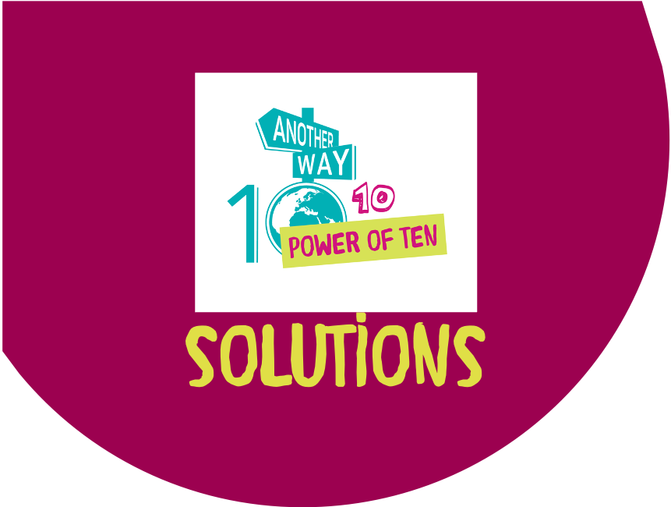
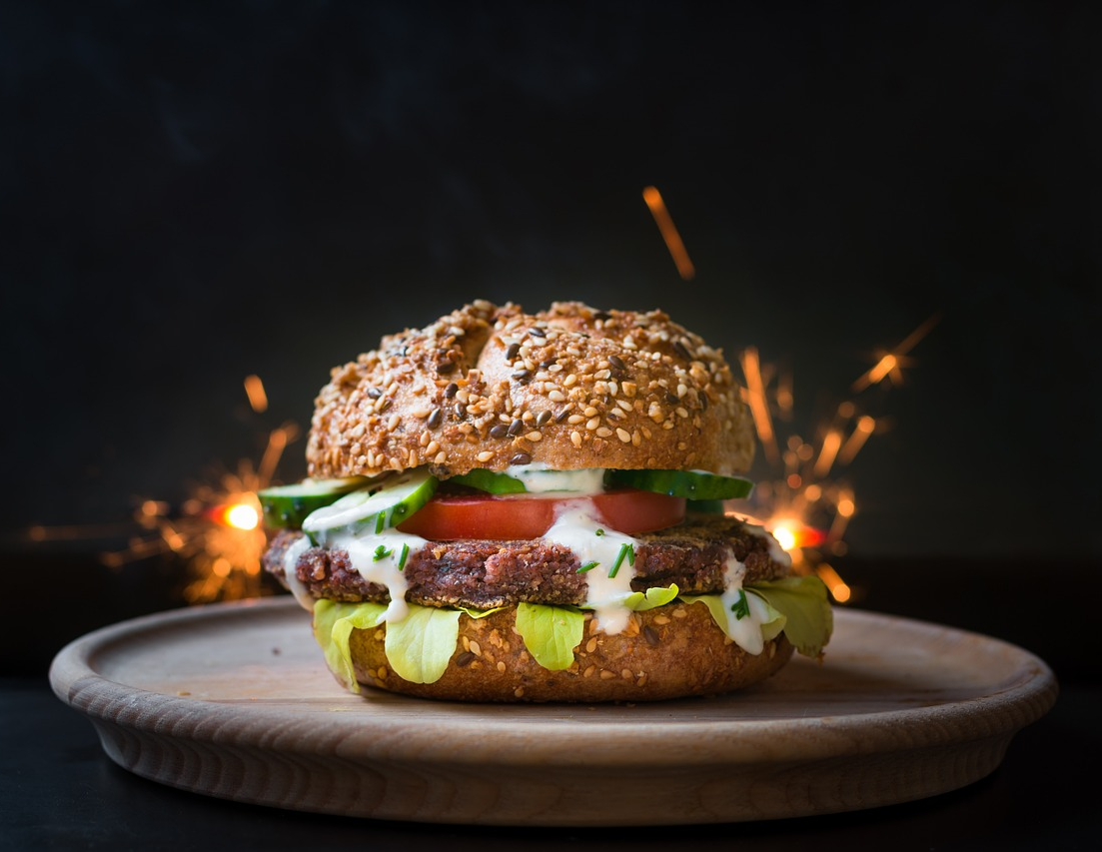
Veggie Burger vs Meat Burger
…try the switch next time…
By choosing a veggie burger you can reduce your carbon footprint by 20 times
Notes:
One of the easiest consumer choices that you can make is picking a veggie burger instead of a beef burger. Most restaurants in the UK have vegetarian and vegan options now, and if you are cooking at home, there are a lot of sustainable options at the supermarkets. So next time you choose what to have for dinner, think, could I make the switch today? If the answer is yes, then you could cut your food’s carbon footprint by 20 times.

Slide 17
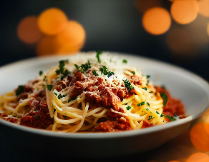
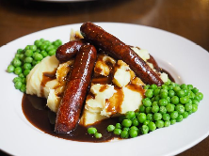
Easy Swaps at Home
Meat swaps
If your family went meat free for 1 day,
it would be the same as not driving for 5 weeks
See our Mooove over meat home challenge booklet for more inspiration
Vegan chicken slices for curries, stews, fajitas etc.
Vegan mince for Bolognese and chillies
Tofu and beans are great protein substitutes
Try a veggie sausage on the bbq instead
Notes:
Here we have outlined some easy vegetarian swaps for you to make in your own home. If you want to find out more, download our Mooove Over Meat Home Challenge, which is packed with recipes for simple vegetarian and vegan meals. If your family were to choose to eat meat free on just one day per week, over a year that would be equivalent to not driving a car for five whole weeks!

Slide 18
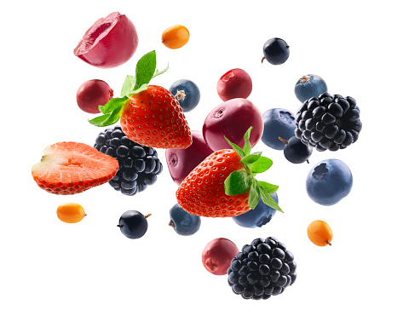
Flying Fruit
Notes:
Let's move onto fruit and vegetables and look at the impacts of our choices.
We are going to play the flying fruit game. I will show you an image of a fruit or vegetable, and you must tell me where you think it comes from and if it comes by plane or boat.

Slide 19

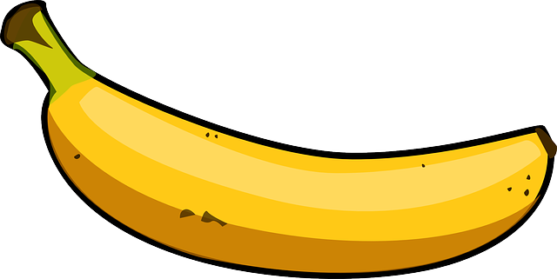
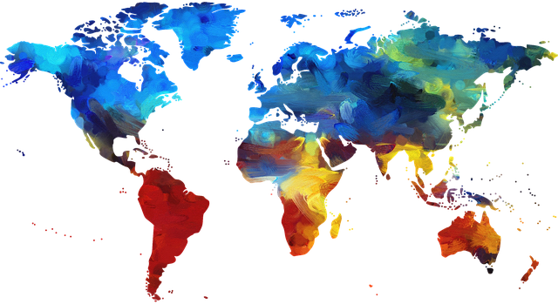
Is it a plane? is it a boat? no, it’s a pineapple!
Notes:
(Play the game with the audience – see accompanying instructions for the game)
So, what is the purpose of this game? As some of you may know, flying produce into the UK is significantly more carbon intensive than transport by boat. Let’s now look at how we can make informed choices when it comes to fruit and veg.

Slide 20
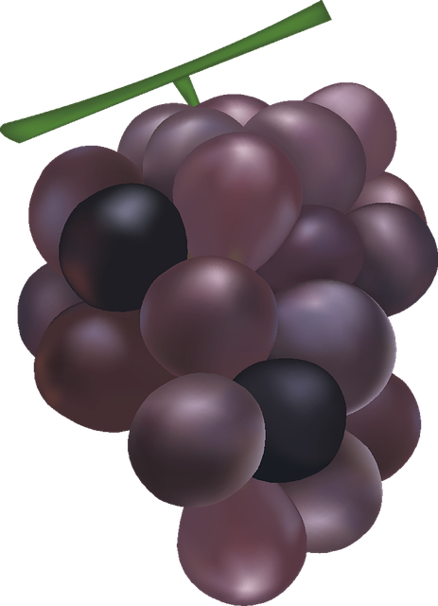
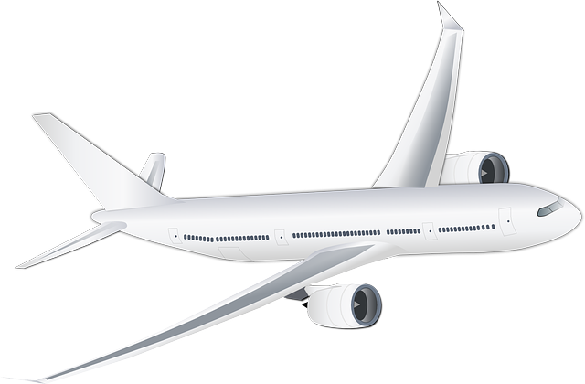
Is it a plane? is it a boat? no, it’s a pineapple!

Slide 21
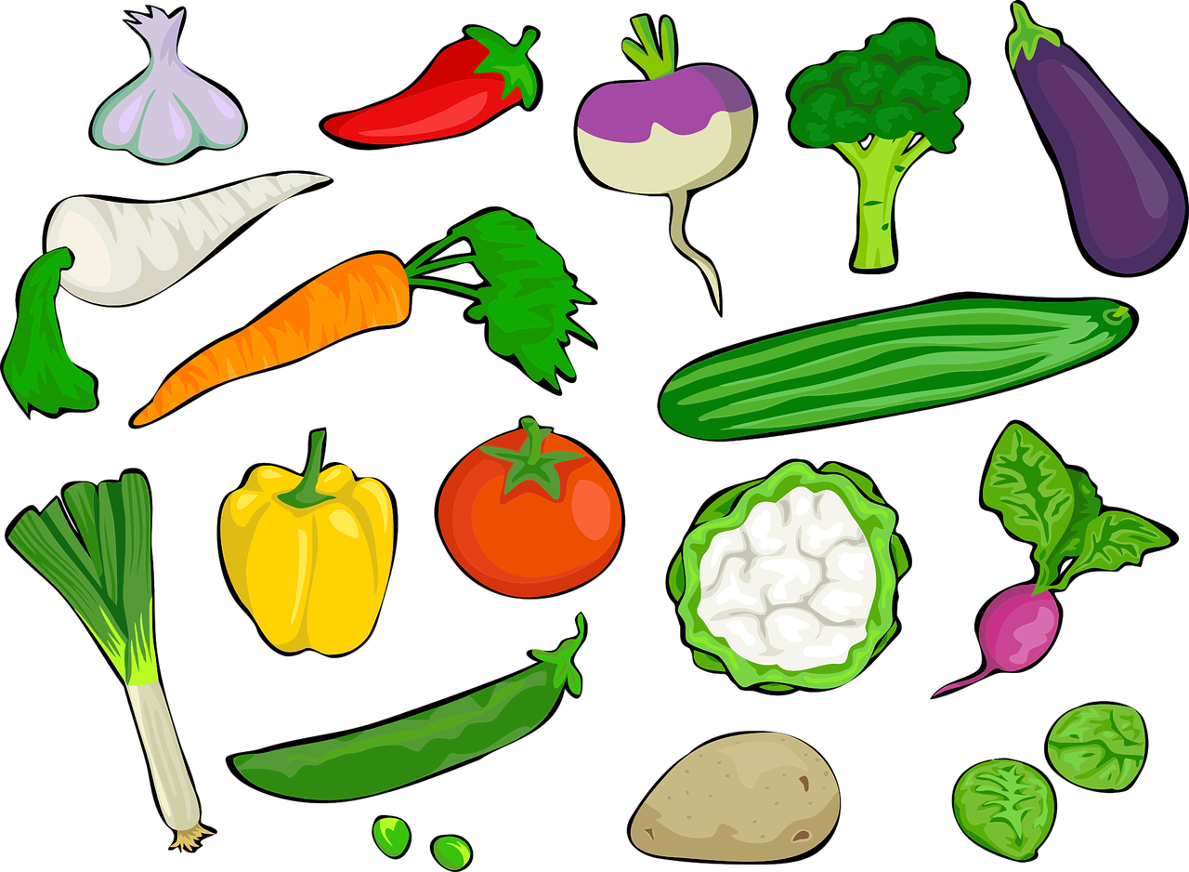
Is it a plane? is it a boat? no, it’s a pineapple!

Slide 22
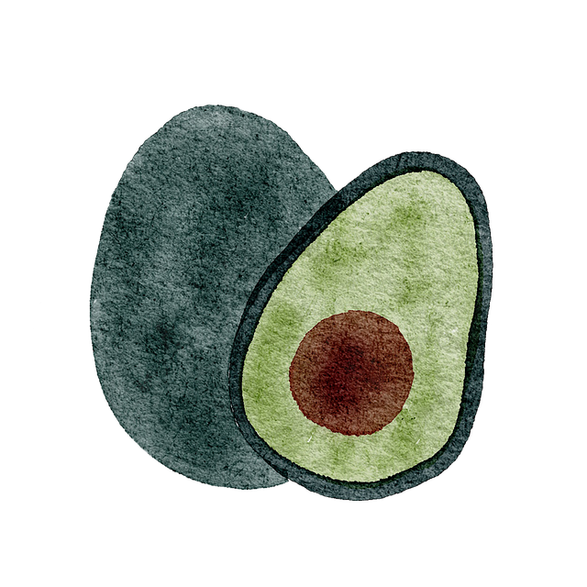
Is it a plane? is it a boat?
no, it’s a pineapple!

Slide 23
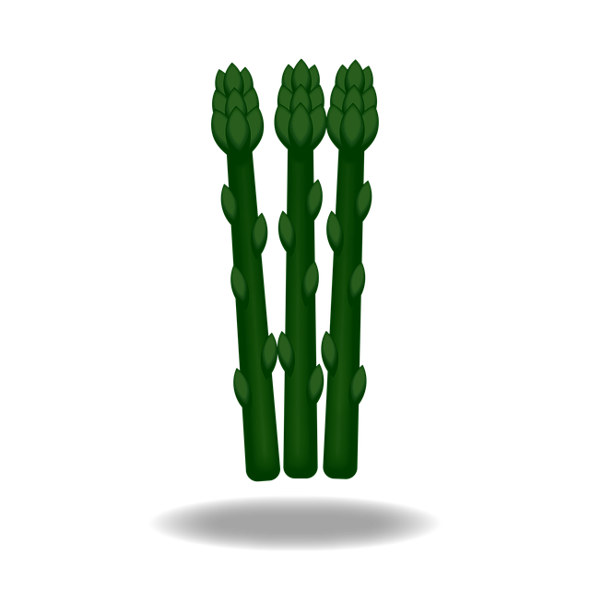
Is it a plane? is it a boat? no, it’s a pineapple!

Slide 24

Is it a plane? is it a boat? no, it’s a pineapple!

Slide 25
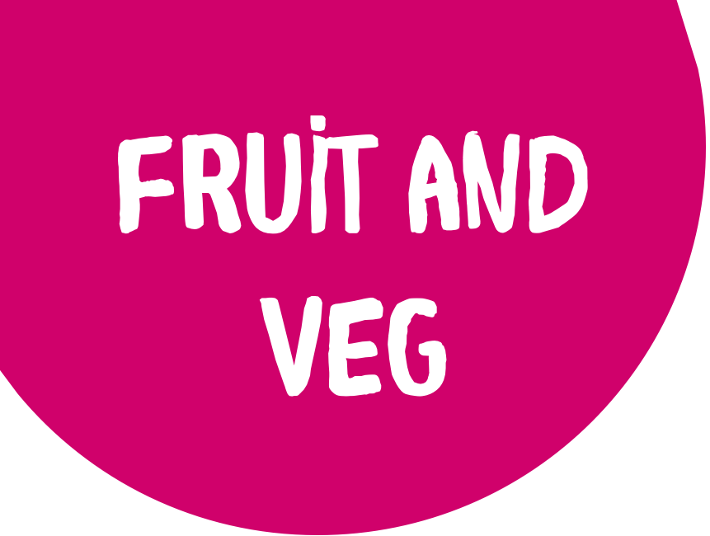

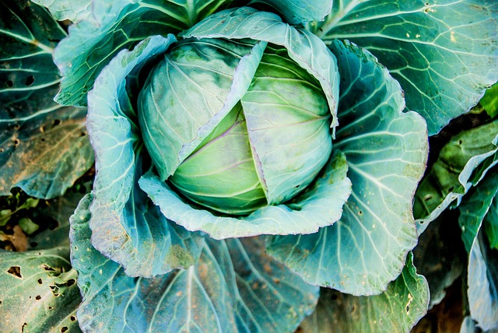
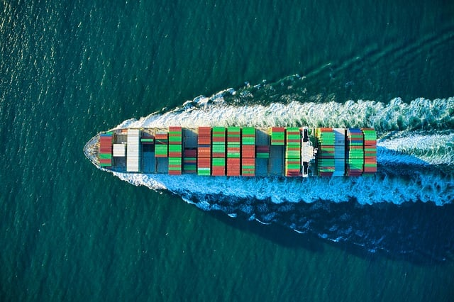
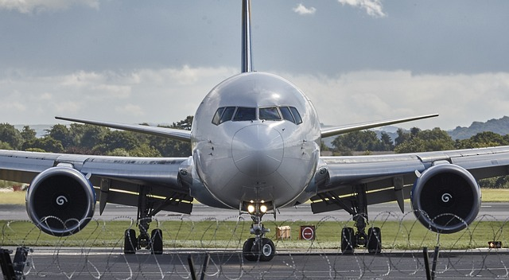
How do we Choose?
Make informed choices
produce arriving by boat has 1% the carbon footprint of airfreighting
If it’s grown in the UK, it should be OK
If it comes by boat, it gets our vote
If it comes by plane.. then think again
Notes:
Generally, if the produce is grown within the UK, it should be ok. However, it's important to note that buying seasonal fruit and veg is important too– we’ll discuss that later. Some fruit and veg that grow year-round include cabbage, pak choi, radicchio (or chicory), bananas, and pomegranate.
If it comes by boat, it gets our vote! Most items that come by boat are much less carbon intensive than products that are flown in from nearby countries. If it has a hard skin or its own protective coating, it's more likely to be transported by boat, and should be ok.
However, if the item comes by plane, think again. Most fruits and vegetables that are flown in are ones that will spoil easily– if it won’t survive on a boat and it has come from another country, it has almost certainly been flown in! In these cases, it’s best to choose something else. There is one more element at play here; let's look at seasonal produce!

Slide 26
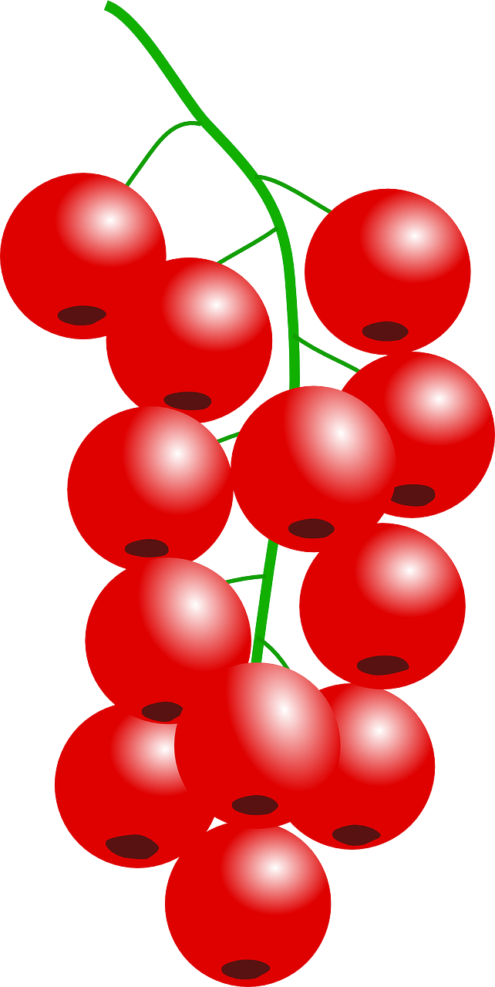



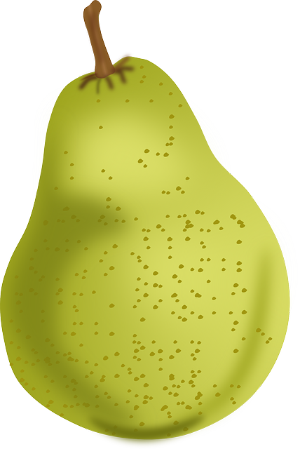
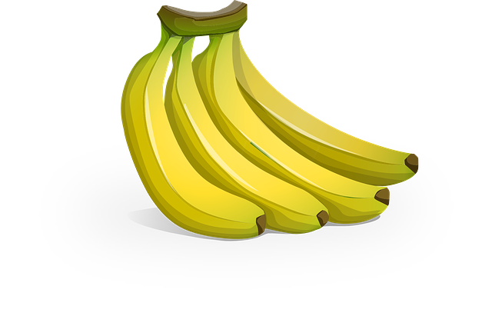





JAN & FEB
Beetroot
Brussel sprouts
Cauliflower
Parsnip
Sweet potato
Apple
Clementine
orange
ALL YEAR
Cabbage
Pak choi
Radicchio
Banana
pomegranate
NOV & DEC
Brussel sprouts
Leek
Kale
Turnip
Cranberry
MAR & APR
Cabbage
Peas
Pepper
Spinach
Potatoes
SEP & OCT
Celery
Artichoke
Kae
Pumpkin
Sweetcorn
Apples
Pears
JUL & AUG
Beetroot
Broccoli
Courgette
Tomatoes
Blackberry
Raspberry
Peach
MAY & JUN
Asparagus
Aubergine
Carrot
Lettuce
Apricot
Cherry
Notes:
If you buy your fresh produce from a farmers’ market or a local fruit and veg stall, you are probably receiving local or home-grown seasonal produce– so that is a great place to start! However, if you want to help reduce your carbon footprint related to fruits and vegetables, be aware of what is in season and when. Have a look at our seasons wheel, find your favourites, and remember (or take note) of when is best to eat them. Always check the label to make sure that the item is not imported and, if it is, choose the UK option. For example often supermarkets will stock apples imported from New Zealand or South Africa and British ones too, so it’s worthwhile checking the label and choosing British when you can.

Slide 27

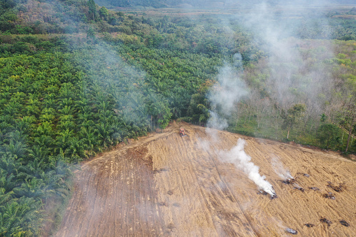
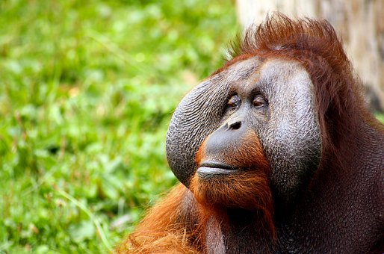
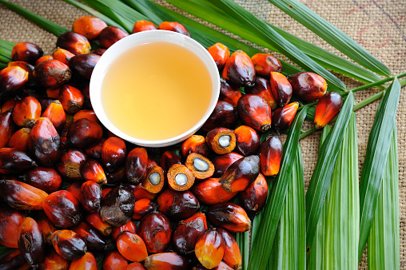
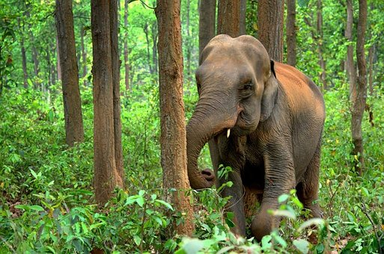
Rainforests : Palm Oil
It drives the illegal logging of rainforests in South Asia
Palm oil is a popular vegetable oil
It has negative impacts on many already endangered species
Notes:
Lastly, an important consideration when shopping for food is whether it contains palm oil. Palm oil is an incredibly prolific substance– over 50% of all products on our supermarket shelves contain palm oil. So, what is the problem with this natural oil? Palm oil production is a modern problem that stems from our relentless need for cheap vegetable oil, such that the oil is now found in many popular high street and supermarket goods. It is cheap and easy to produce but requires vast areas for plantations, which are often established in areas of primary rainforest. Palm oil production has been the biggest driver of deforestation across southern Asian countries, such as Malaysia and Indonesia. Although efforts have been made in these countries to protect the rainforests, illegal logging continues as palm oil production is a lucrative business. This deforestation leads to habitat loss for countless species that depend on these rainforests, such as orangutan, pygmy elephants, Sumatran rhino, sun bears, and countless tropical birds and reptiles.

Slide 28
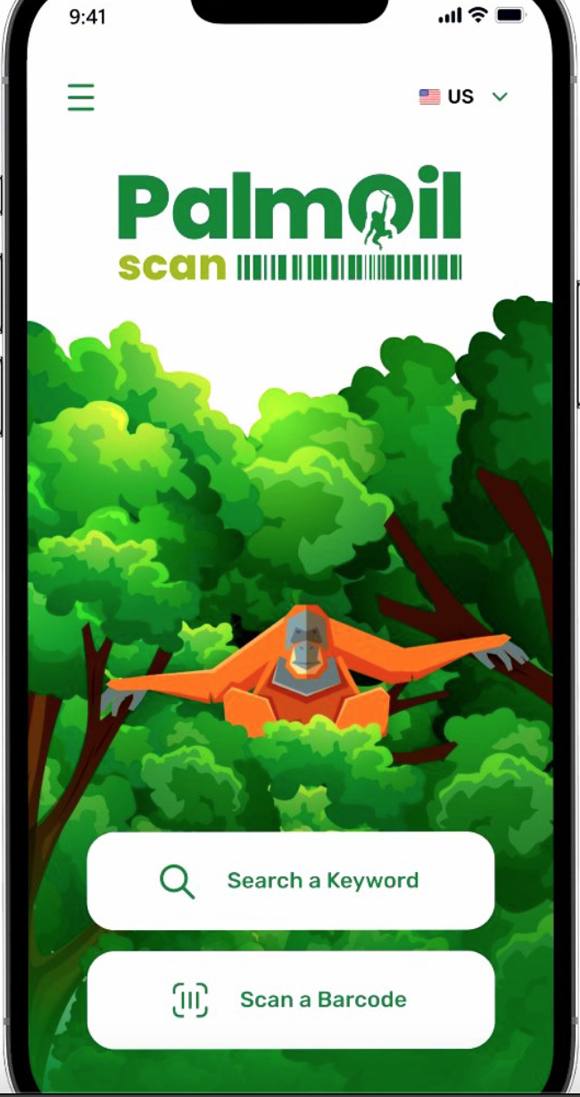
Go palm oil free
Download the Palm Oil Scan App created by Chester zoo
Notes:
The easiest way to ensure that you are not buying palm oil is to check on the label for the ingredients– if you see palm oil listed as an ingredient, don’t buy the product. You can also search for sustainable palm oil labels, which should suggest that the plantations are responsibly managed so that primary rainforests are not destroyed. However, be aware of greenwashing and always check your sources. If you are unsure, check the reputation of the label online!

Slide 29
Solutions
Together We Can
fix our future
CONSUME : Be a conscious consumer.
EDUCATE : Learn more about the topic.
DO : Be Proactive. Get involved.
DISCUSS : Share knowledge with friends and family.
Notes:
The issues with our food system may seem massive, but as we have seen, there are so many impactful ways we can make change as individuals and communities. Imagine if all 8 billion of us boycotted palm oil. The greatest threat to our rainforest would disappear overnight. The power of collective action is enormous, but it starts with all of us deciding to take matters into our own hands and to speak out on behalf of nature.

Slide 30

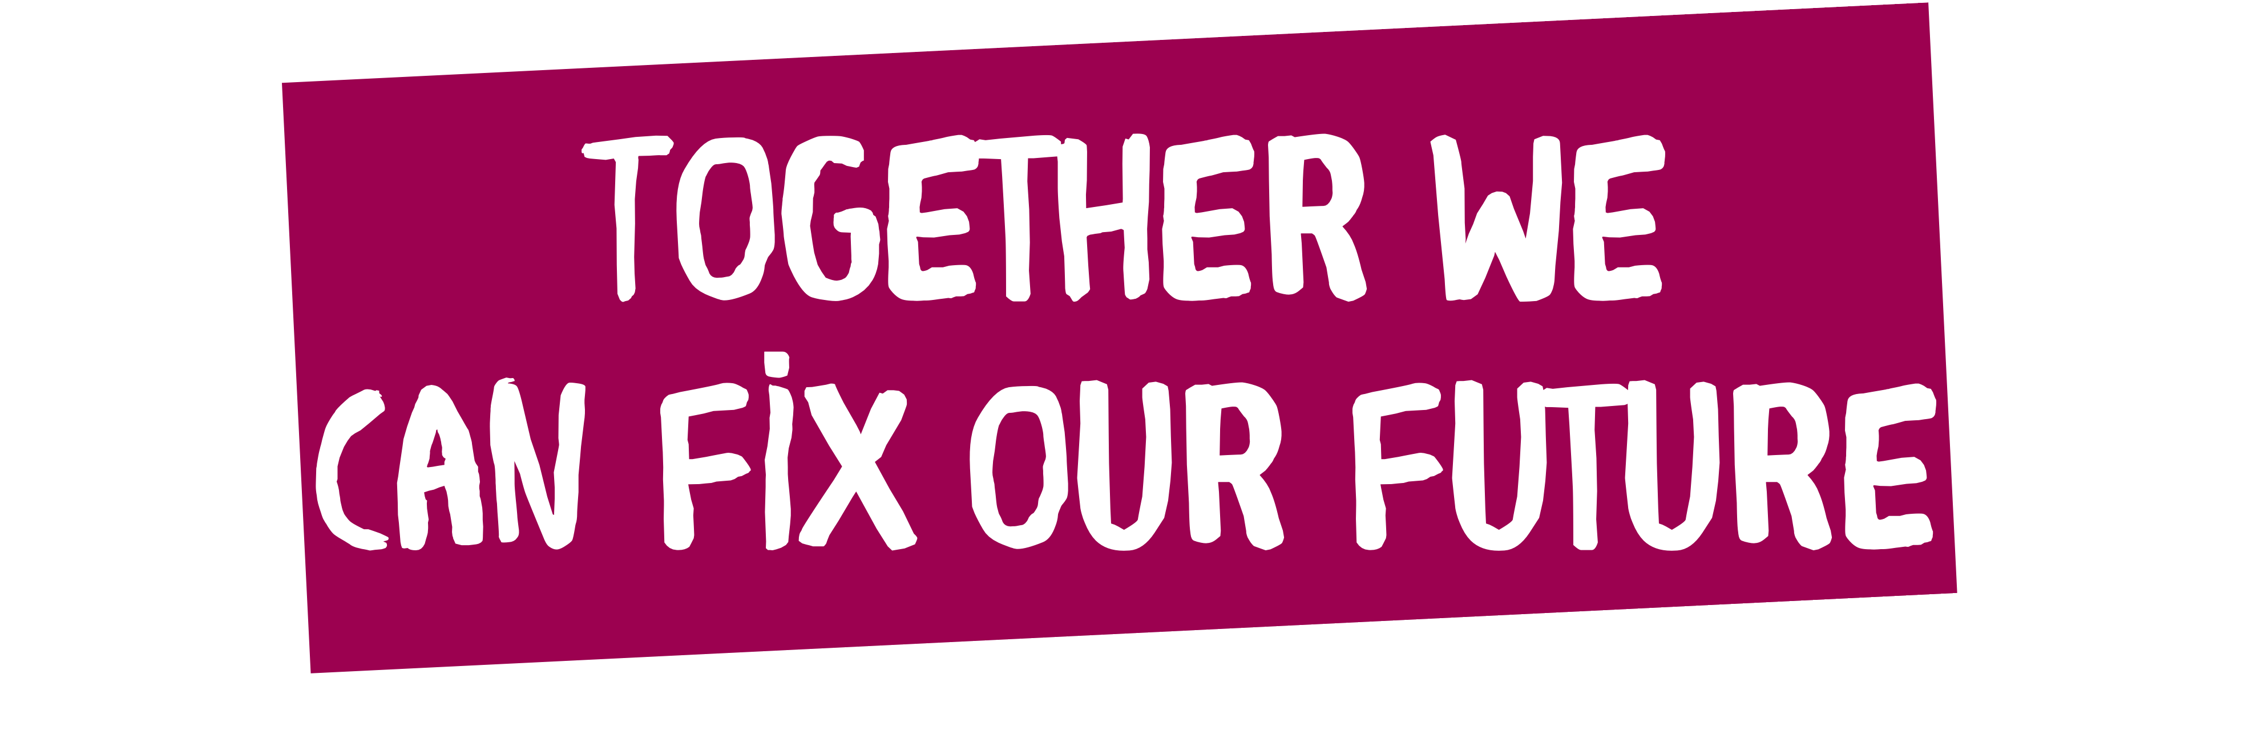

www. Powerof10.earth
THANK YOU !
Notes:
We hope that by seeing this presentation you are inspired to make sustainable choices in your lives that suit your own lifestyles. Please see our Power of Ten platform for more inspirational resources on how to help you live a life that is kinder to the planet and on how to spread these messages to others. We have plenty more topic-based resources to help you learn more too.
We hope to see you on the Power of Ten platform, just search Power of Ten to find out more or visit Powerof10.world.

Slide 31
THANK YOU !

