Slide 1
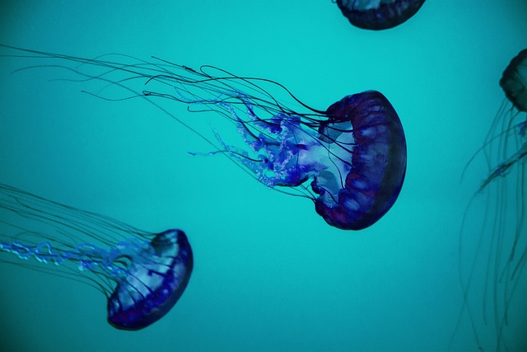
Key theme presentations
Our Oceans
Notes:
Another Way is a charity founded in 2019 by Amy Bray, when she was just 16. Another Way connects passionate individuals who care about making lifestyle changes for the benefit of a healthier planet. They do this by providing resources, guidance and connections through the Power Of Ten platform. Individuals take inspiration and information into their communities to start conversations around sustainable lifestyles and influence change.
Another Way has produced an Oceans Pack which provides
Science-based information about the problems with our oceans
Solutions that are already in place and
Actions that you can take to help our oceans
This slide deck accompanies the Oceans Pack. It provides an insight into the interconnectivity of our planet’s delicate relationships, illustrating, that if we change one thing it can have a knock-on effect on another. Our overall aim should be to help to restore nature's relationships that we have disrupted.

Slide 2
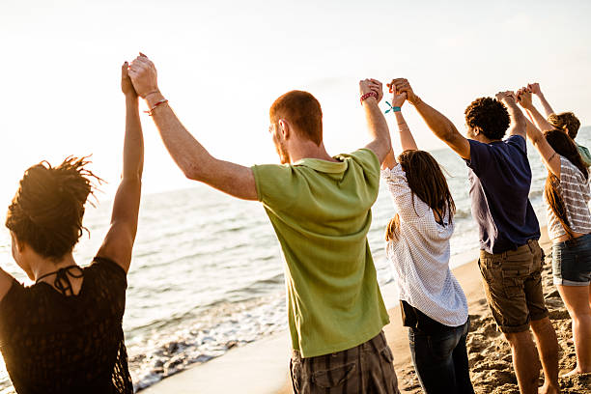
Power of ten mission
If 1 person tells 10 people and those ten people tell 10 more… within 10 days the whole world will have been inspired
Problem. Solution. Action.
Notes:
The Power Of Ten is a platform set up for young environmentalists. @
The Power of Ten is defined as follows:
If 1 person tells 10 people and those ten people tell 10 more… within 10 days the whole world will have been inspired.
Based on this theory, Another Way spreads positive messages about what can be done if we all make small changes to help our planet.
The presentation gives an insight into the main problems that the climate is facing. After understanding the problems, we provide inspirational action that you can take to make positive changes for you and the planet. You can then share this with others, spreading messages and realising the Power of Ten.

Slide 3
Overview
Our ocean
ocean plastics: The Problems and Solutions
ocean warming: The Problems with a warming ocean
overfishing: Industrial fishing methods
Notes:
We will discuss 3 main problems that the oceans are facing now. These are by no means the only problems; however, they are some of the most important to highlight.
First, plastics in the oceans, focusing on single-use plastics. We provide alternatives and will discuss our options in breakout sessions.
Next will be our coral reef systems, focusing on the impact of ocean warming. We suggest solutions and will discuss in breakout sessions
Thirdly will be looking into overfishing, again providing tangible solutions and breakout sessions.
We will then hear some Good News Stories from the oceans.

Slide 4
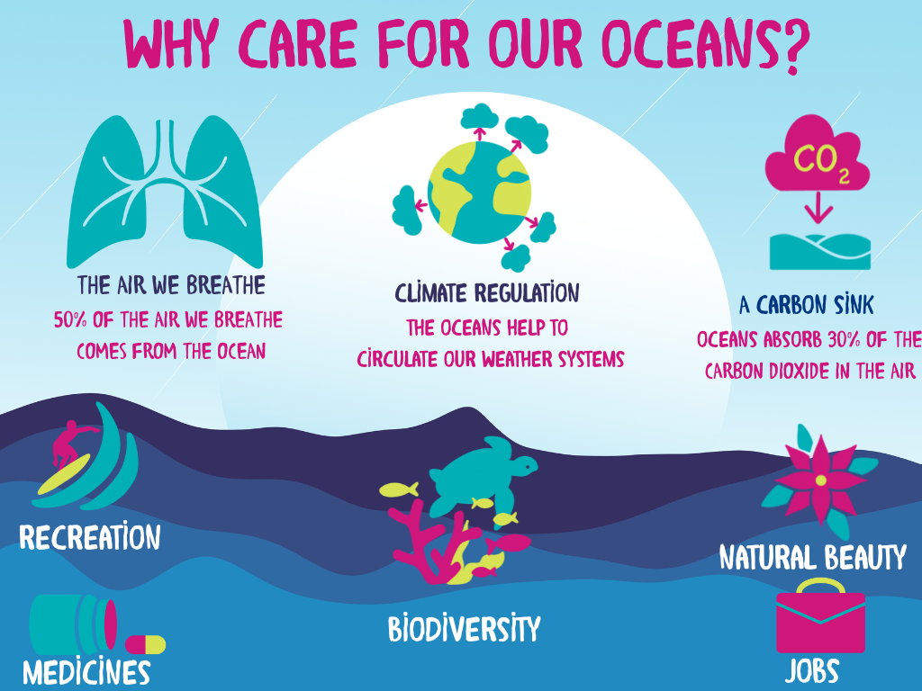
Ocean plastics
Why care for our ocean
Our Oceans are the basis of all life
Notes:
Why should we care for our oceans, it’s just water right?...!
Well, our oceans cover over 70% of the entire world. And and make up about 96.5% of all of earth's water! Although many of us don’t live next to the ocean, the oceans provide us with much more than just a nice place to swim.
Let’s do a little activity:
Take a big breath in…. now, let it out, take 1 more big breath in, and let that one out…
That second breath you took was thanks to the oceans. Tiny organisms that live in the ocean, called phytoplankton, provide us with oxygen just like trees do. The forests provide us with around 50% of our oxygen to breathe and the oceans provide the other half.
The oceans are similar to our forests in another way too, by acting as a carbon sink, meaning that it absorbs CO2 from the atmosphere.
The oceans help to provide us with food, medicines, recreation and jobs for many across the world. It also helps to regulate the climate by circulating warm and cold air through the atmosphere which influences our weather patterns all around the globe. For example - Did you know that if it weren't for the north Atlantic current known as the Gulf Stream, the UK would be 3.4 degrees colder? Yep, our little island should be a much colder place, but the oceans keep us warmer... Thanks Ocean! J
The health of the entire planet and ourselves depends upon a healthy ocean – so let’s look at the problems facing it right now.

Slide 5
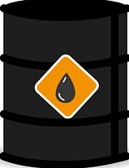

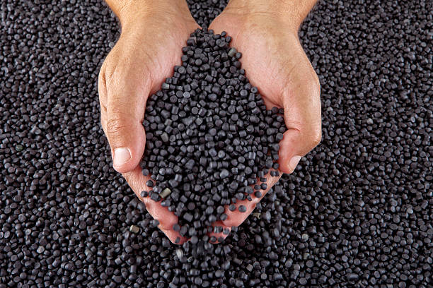
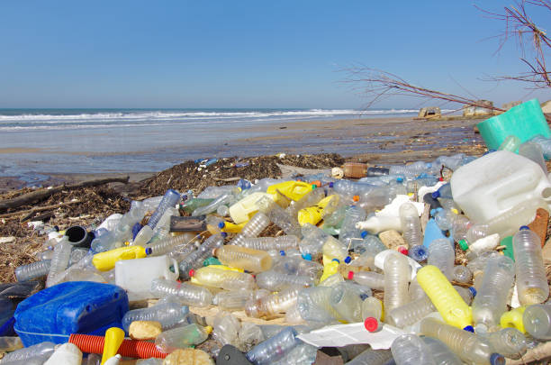
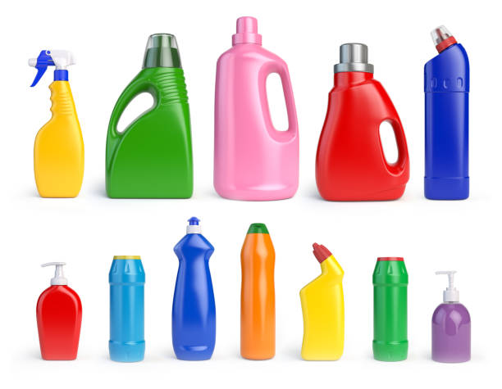

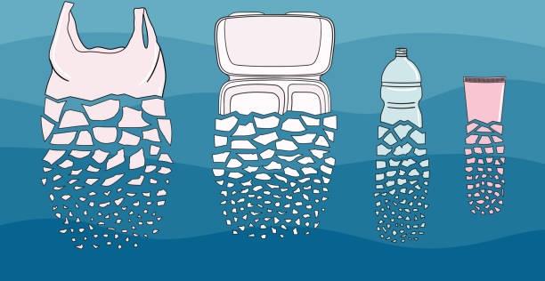
Ocean
plastics
Plastic lifecycle
Traditional plastics are made from oil
7.
6.
1.
They start to break down due to various factors...
Weather and time cause these plastics to get swept into waterways
Oil is extracted
2.
Oil is then turned into plastic pellets
If put in the bin, they end up in landfill
5.
3.
Which is then turned into plastic items
4.
Some plastics
can get recycled
Notes:
Let’s start with plastics
First let’s get back to basics, why is plastic such a big problem?
Q : Does anybody know what is plastic made out of?
A : Yes, plastic is made from oil!!
Plastic starts life as oil – yes oil! But why is oil a problem? Oil is a fossil fuel, which means that it is taken from far beneath the earth’s surface where it has been stored for millennia. By keeping this oil in the ground, we can help the planet to keep its natural balance, however, when we extract it, it disrupts the balance of gases and causes problems with our planet's natural systems. This is one of the main drivers of climate change. For more info on this see our climate change slide deck.
Oil is turned into plastic pellets by heating. These pellets are then moulded into various plastic items that we use each day.
If you recycle the plastic product that you buy, then it will go back into a process where it is melted down and re-moulded. That’s a good idea, right?
Unfortunately much plastic cannot be recycled. In fact, less than 10% of all plastic that has ever been produced has actually been recycled. And plastics can usually only be recycled once before the quality gets too poor.
If the plastic is not recycled and ends up in the regular bin, it will get taken to a landfill site. A whopping 79% of plastic is sent to landfill. These large sites are meant to be designed to store rubbish – however, as these sites are open-air and essentially giant holes in the ground, it means that objects can easily blow away, be washed away or wildlife can come and take items. Some then get into our rivers and lakes.
Once in our waterways, these plastics will either find themselves in the oceans or in the stomachs of some marine animals. We will look at what happens to plastics when they breakdown later but as you can see by the pictures, they never actually go away and end up becoming what’s known as microplastics.
We have made a huge amount of plastic since we discovered it in the 19th Century….
By heating up the oil, instead of burning it to get energy, it can be turned into plastic pellets, which can then be moulded into various plastic items that we use each day.
If you can recycle the plastic product that you buy, then it will go back into a process where it is melted down and re-moulded. However, much plastic cannot be recycled. In fact, less than 10% of all plastic that has ever been produced has actually been recycled. And plastics can usually only be recycled once before the quality gets too poor.
If this plastic is not recycled and ends up in the regular bin, it will get taken to a landfill site. A whopping 79% of plastic is sent to landfill. These large sites are meant to be designed to store rubbish – however, as these sites are open-air and essentially giant holes in the ground, it means that objects can easily blow away, be washed away or wildlife can come and take items.
Once in our waterways, these plastics will either find themselves in the oceans or in the stomachs of some marine animals. We will look at what happens to plastics when they breakdown later but as you can see by the pictures, they never actually go away and end up becoming what’s known as microplastics. And we have made a lot of plastic since we discovered it in the 19th Century….

Slide 6
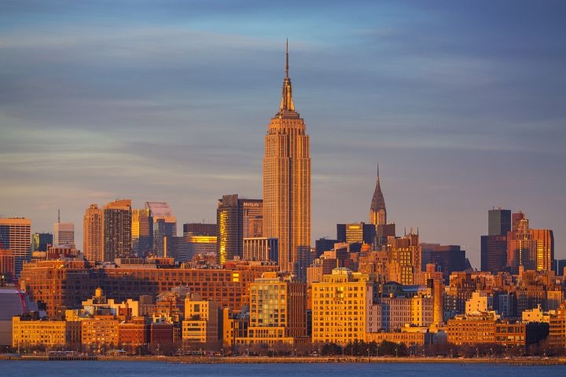
9 billion tonnes
250 000 empire state buildings
Notes:
Roughly 9 billion tonnes of plastic, has been produced in the last 100 years. That’s equivalent to 250,000 (quarter of a million!) empire state buildings. Our rate of production has grown 20-fold in the past 50 years, and production is expected to double again in the next 20 years - unless we do something to stop it.

Slide 7
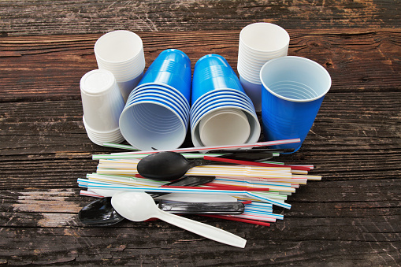
Ocean plastics
OCEAN GYRES
What are Single use plastics?
Single Use Plastics are items made of plastic that you use only once.
Single use plastics are items made of plastic that you use only once.
Why do they matter?
All plastic that has ever been made still exists in the world today
How does that impact the world?
If we use an item only once then all the energy and resources that went into making that item has to be repeated again and again.
Notes:
So, we’ve talked about how plastics are made, but what about single-use plastics:
Q: What are single-use plastics? Why do they matter?
A: Single-use plastics are items made of plastic that you use only once. All plastic that has ever been made still exists in the world today. Used only once, single-use plastics increase the demand for more plastic production, which in turn fuels the demand for oil extraction.
As these items are often small and made from flimsy plastic, most cannot be recycled which has a massive impact on the amount of plastic that end up in the landfills and ultimately into our environment and waterways.

Slide 8
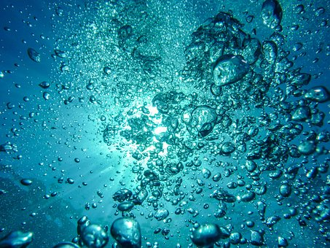
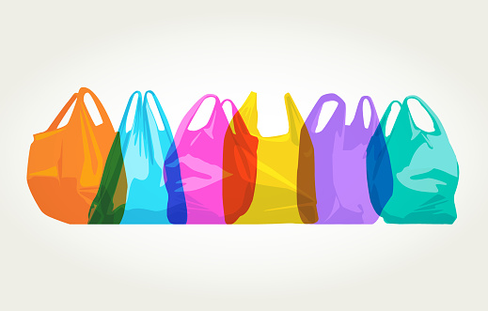
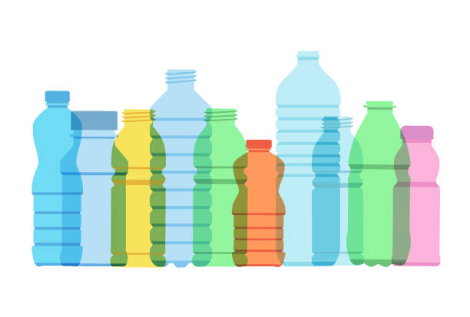


Ocean
plastics
SINGLE USE PLASTICS
By 2050 there
will be
more plastic than fish
in the oceans
Notes:
Let’s take a look at the most common single-use plastic culprits.
Q: Tell me what single-use plastics can you think of?
(Ask participants to shout out what they can think of is a single-use plastic. Write down new ones on the white board as they are shouted out and uncover the slide when you have heard most of them.)
OPTIONAL : Now - I want you to think about the last week... Write down 1 point for every single-use plastic that you have used. For example, if you used a plastic bag today, and yesterday and every day for the past 7 days, you’ll score 7 points. The winner is the person with the fewest points.

Slide 9
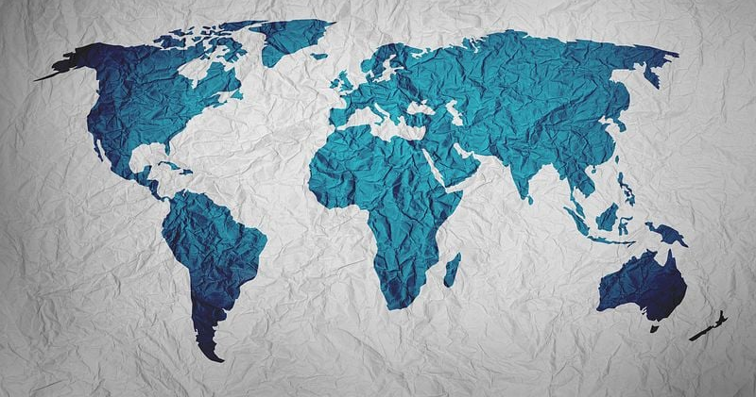

Ocean plastics
OCEAN GYRES
5 Massive Ocean Currents that collect
plastics and debris from the ocean
THE GREAT PACIFIC
GARBAGE PATCH
= 3 x size
of France​
North
atlantic gyre
North
Pacific gyre
Indian ocean gyre
South pacific gyre
south
atlantic gyre
Notes:
Once they have entered the ocean, these plastics are very unlikely to make it back out again and as such massive swathes of rubbish and debris accumulate in patches across the oceans. There are 5 main ocean currents in the world. These are known as gyres. Plastics in the oceans are so light that they get carried through the seas and end up circulating in these massive gyres. One of which is known as the Great Pacific Garbage Patch – The Great Pacific Garbage Patch is 1.6 million km squared which is 3 times size of France. But it’s not quite as simple as cleaning up a regular garbage patch, many of the plastics are so small that they just hang in the ocean, almost like a soup made of plastic, and of course this affects all the delicate life in the oceans, these plastics leach toxic chemicals which can be absorbed by wildlife.

Slide 10
Breakout activity
What’s in your bag?
Work in pairs and each find as many things as you can that are plastic
Discuss what you could swap out for a reusable
Write it down on your Pledge Sheet / Bag
Notes:
Work in pairs and each find as many things as you can that are plastic.
Discuss what you could swap for a reusable or a non-plastic option.
Write it down on your Pledge Sheet / Bag

Slide 11
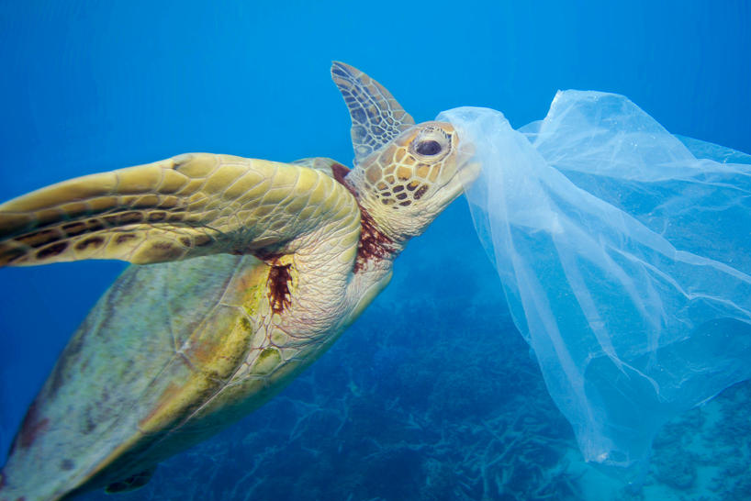
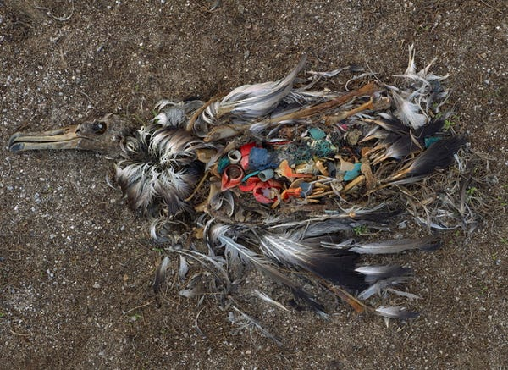
Ocean plastics
Ocean
plastics
WILDLIFE EATS PLASTIC
100% of Sea Turtles have plastic inside them
80% of Sea Birds have plastic inside them
Turtles think plastic bags
are jellyfish​
Birds think colourful
plastics are foods
Notes:
So that’s a lot of plastic right? In addition to all this plastic putting strain on our planet’s resources, it is also bad news for our sea creatures. Here are just a few of the animals that are impacted because of all this plastic in the oceans.
Turtles: Plastic bags look a lot like jellyfish so turtles often try to eat them
Q: What percentage of turtles do you think have plastic in their stomachs?
A: Every single sea turtle - they consume plastics all the time, even the tiniest of plastics can get into turtles' stomachs and if too much is in there they can starve and the plastic can also make them too sick.
Q: What percentage of seabirds do you think contains plastic
A: 80% and this is expected to rise to 99% by 2050
Seabirds eat fish that contain plastics, but they also eat plastic found on the beaches and coasts – as plastic is often colourful – they eat it mistaking it for seeds and fruits.

Slide 12
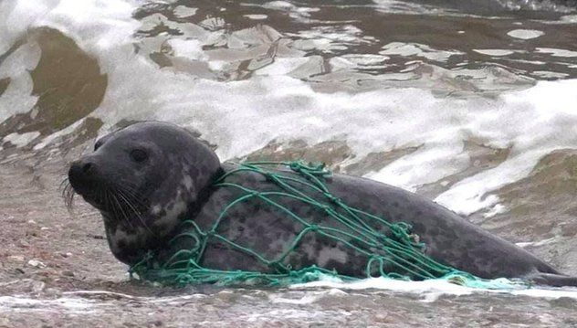
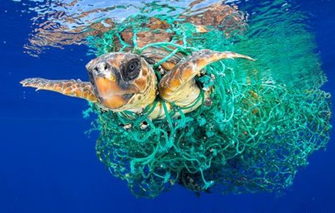
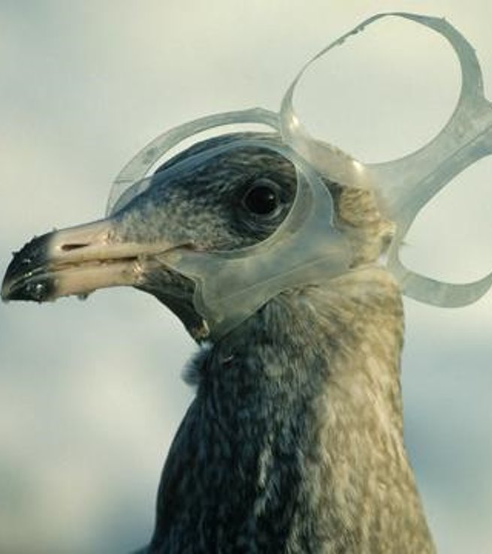
Ocean plastics
OCEAN PLASTICS: TRAPPED WILDLIFE
100 million marine mammals are killed by plastics each year
50%
of ocean plastics are "ghost" fishing nets
Notes:
This plastic impacts wildlife as animals become entangled in it. They can’t remove it and are then stuck for the rest of their lives, unless they get rescued by humans. Some creatures are found to have grown with plastics on them, deforming their bodies. Unfortunately, 100 million marine mammals are killed every year by plastic! Fishing nets are one of the main problems - 50% of ocean plastics are "ghost" fishing nets – which means that they are fishing nets which have been discarded, lost or abandoned.

Slide 13
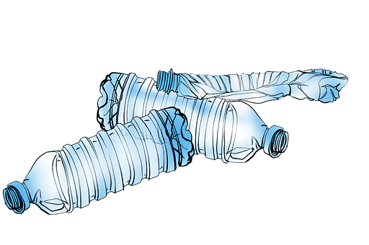
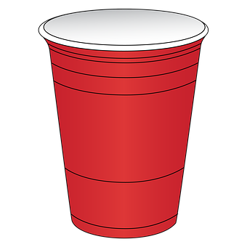
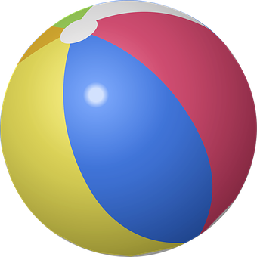
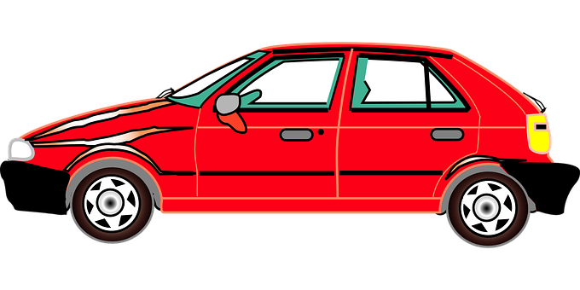

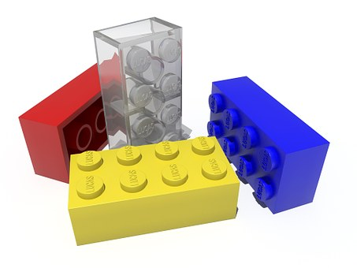

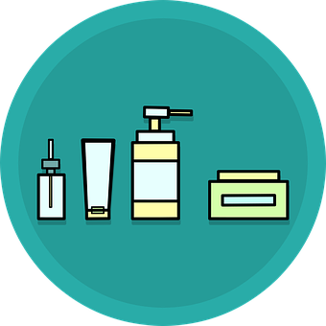
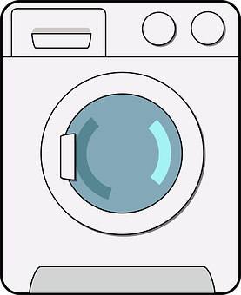

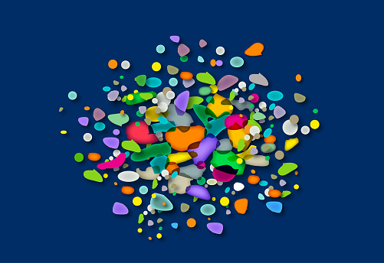
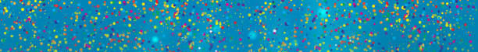
Ocean plastics
WHAT ARE MICROPLASTICS?
The tiny plastics that you
don’t see in things
Larger plastics
breaking down into microplastics
Notes:
In an earlier slide, we discussed how, over many years, hard plastics can breakdown to form microplastics. Weather, waves and time, will break down all plastic items eventually break down into tiny plastic particles. These circulate throughout our oceans and will NEVER disappear.
Microplastics are present in items that we may not expect to be in.
Car tyres release microplastics that then get washed into the waterways. Microplastics are also in clothes made of nylon, or other synthetic fabrics. These get washed out through washing machines, and believe it or not, shower gels and shampoos can contain microplastics too which get washed down our drains and end up in the oceans.

Slide 14
Breakout activity
The unusual suspects
Which of these common
household items contain plastic?
Notes:
In this activity, I will show you a series of images and you have to guess whether or not they can contain plastics.
(See user manual for info and facts on each item)

Slide 15

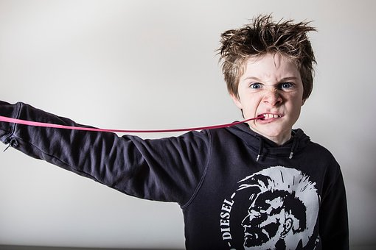

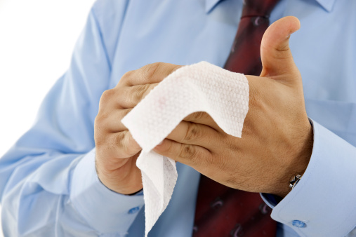

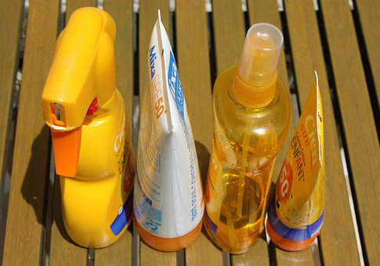
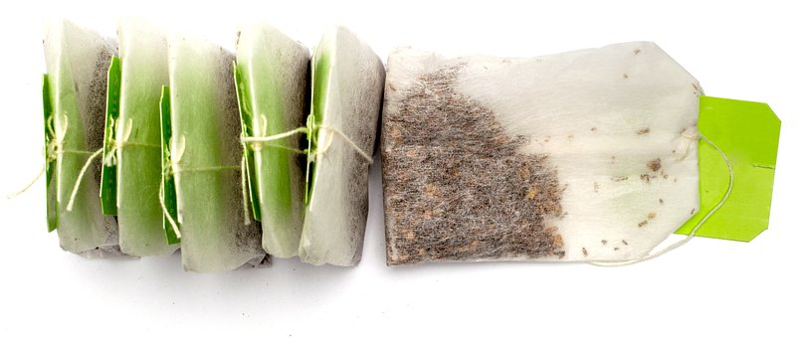
Notes:
All these tiny microplastics that we cannot see can do great harm to our sea creatures and in the end us… let’s check out how this all affects us as humans.
As microplastics are tiny, they can be eaten by tiny creatures. This is the start of our food chain. Plankton eat these tiny plastics, and small fish eat these plankton, larger fish eat these smaller fish and we catch these larger fish for our consumption, in fact 1 in 3 fish caught contains plastic, so if you’ve had 3 pieces of fish recently, chances are that one of them had plastic inside. Not a nice thought, is it?!
At Power of Ten, we are all about providing solutions, - this all does sound like a whale of a problem!! And let’s be honest it is, but every single one of you has the opportunity to help change the direction that this problem is headed by just thinking about what you do, how you do it and who you talk to.

Slide 16
Ocean plastics
PLASTIC FOOD CHAIN
1 in 3 fish caught contains plastic
Big or small – these plastics get eaten by animals.
Plankton ingest
these microplastics
Fish eat
plankton
Larger
animals
eat the fish
All of this ends up on our dinner plates
Notes:
All these tiny microplastics that we cannot see can do great harm to our sea creatures and in the end us… let’s check out how this all affects us as humans.
As the microplastics are tiny, they can be ingested by tiny creatures, in fact plankton eat these tiny plastics, and small fish eat these plankton, larger fish eat these smaller fish and we catch these larger fish for our consumption, in fact 1 in 3 fish caught contains plastic, so if you’ve had 3 pieces of fish recently, chances are that one of them had plastic inside. Not a nice thought, is it?!
But, at Power of Ten, we are all about providing solutions, - this all does sound like a mammoth problem, and let’s be honest it is, but every single one of you has the opportunity to help change the direction that this is headed by just thinking about what you do, how you do it and who you talk to.

Slide 17
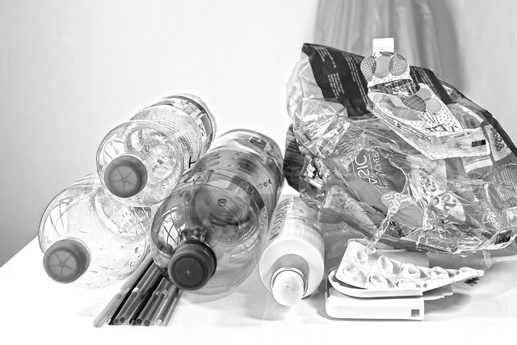
Just say “no” to plastics
Notes:
How can we help curb this plastic problem.. If someone offers you a single use plastic – simply no if you can.

Slide 18
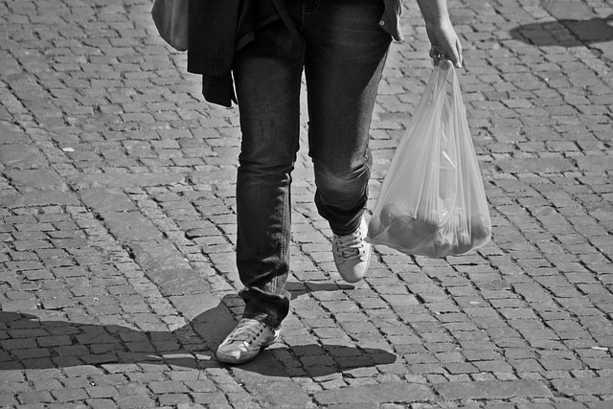
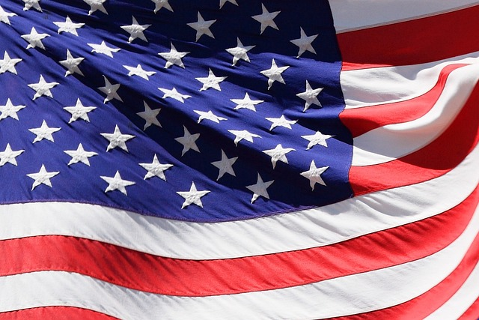
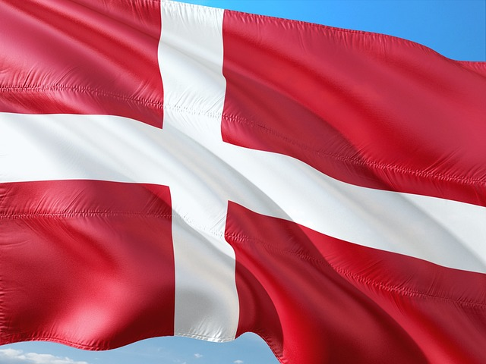
365 per
person per year
4 per
person per year
Notes:
To show how behaviour change can affect consumerism. we just need to look at the difference between Denmark and American. Denmark has a plastic bag fee, any time they have to use a plastic bag, this results in Danes only using 4 plastic bags per person per year. Compare this to American where this no such fee and you can see they get through at least 1 plastic bags every day of the year. So let’s loo at how we can change our addiction to single use plastics…

Slide 19
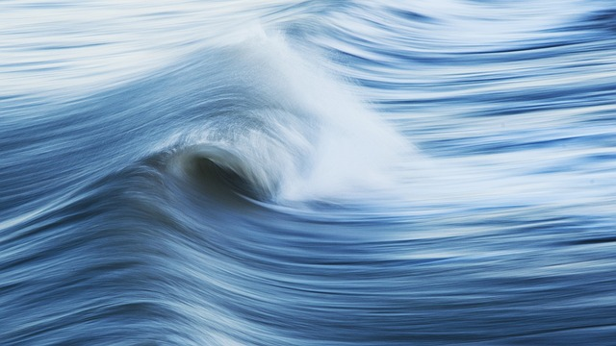
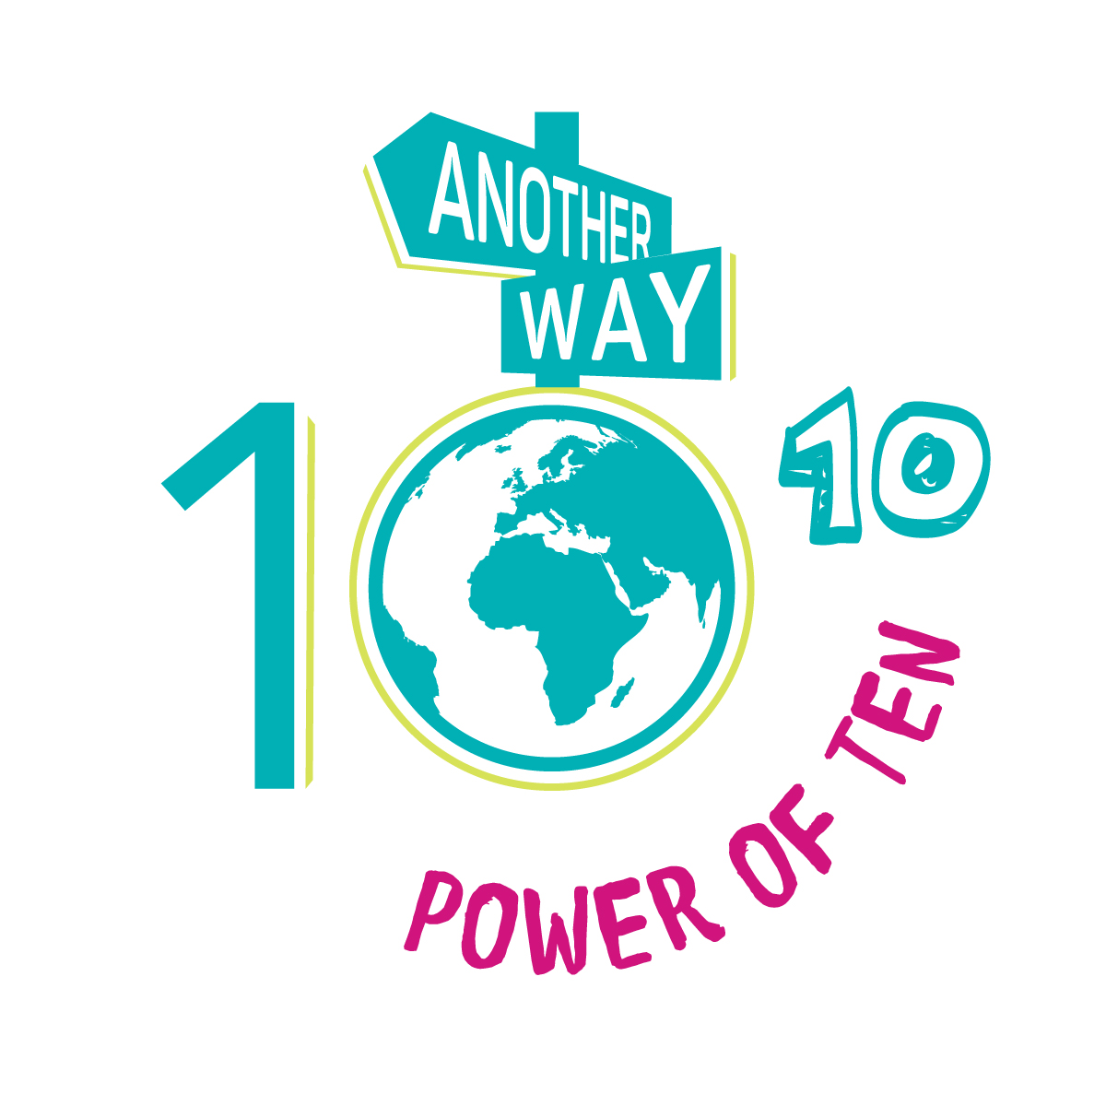
Solutions
TOGETHER WE CAN fix our future
CONSUME : Be a conscious consumer
EDUCATE : Learn more about the topic
Do : Be Proactive. Get involved.
DISCUSS: Share knowledge with friends and family
Notes:
Our Power Of Ten Solutions are broken down into categories for actual actions that you as people on this planet can do.
Consume
BE A CONSCIOUS CONSUMER – with every purchase – think!
EDUCATE – Learn More about the Topic– Education leads to knowledge and knowledge leads to action. The more you learn, the more you care, the more likely you are to do something about it.
DO - Be Proactive and Get Involved – Imagine if every single person on the planet stopped using plastic, very soon our demand for plastic would completely stop.
DISCUSS - Share Your Knowledge – Spread the word and get people talking about these issues and solutions.

Slide 20
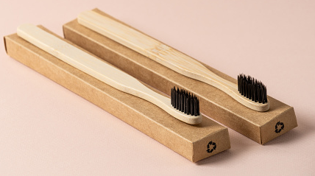
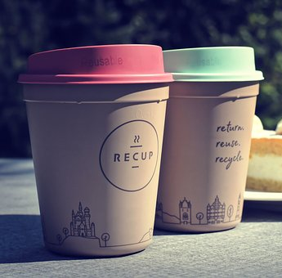
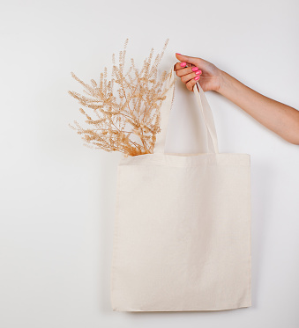
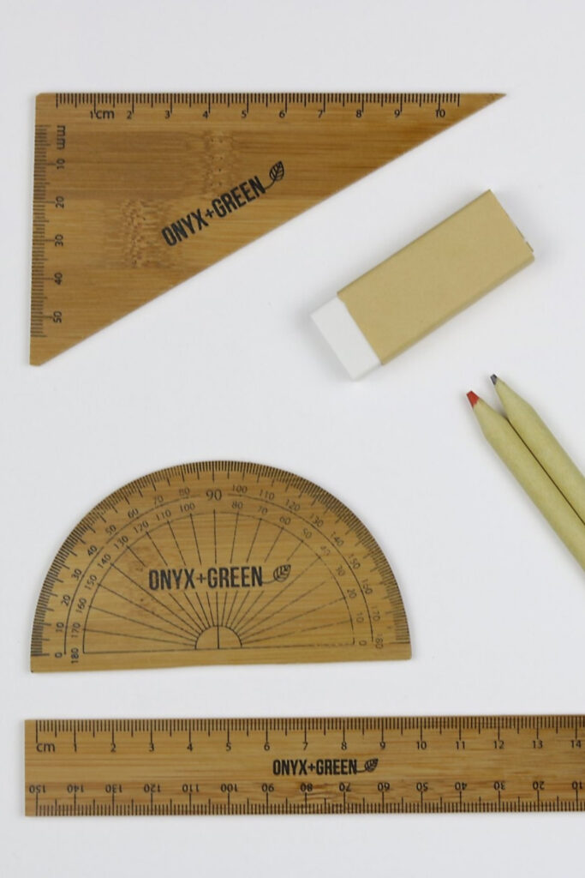
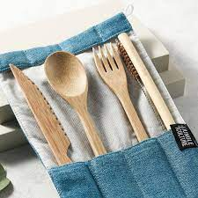
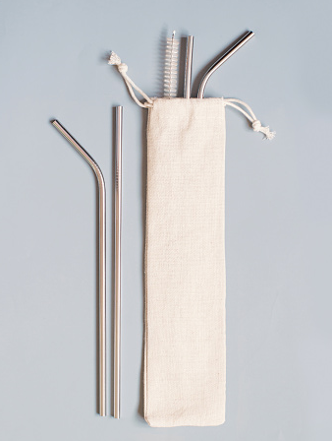
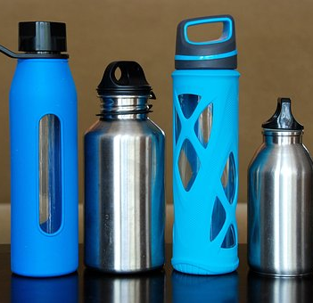
TAKE REUSABLES AND CHOOSE NON-PLASTIC ITEMS
solutions
When buying something, look for its eco-friendly twin!
Notes:
Having discussed the importance of avoiding single-use plastics, let’s think about how we can stop contributing to this problem.
Firstly just say no to plastic items when you are offered them. Does that 1 apple you are buying really need to be in a plastic bag. Do you really need that plastic straw for your drink? Just politely say, thanks but I don’t need that plastic bag and one less piece of plastic will have been used.
On average a plastic bag is used for 12 minutes and then discarded. If everybody used reusable bags instead of single-use plastic bags, then the demand for these bags would decrease.
Let’s look at an example. In America the average amount of plastic bags used per person per year is 365 (that is one every day!)… In Denmark however, this is 4 plastic bags per year… imagine if all countries only used 4 plastic bags per year, we would have a very different situation… If people use alternatives for carrying their shopping, then we could turn the tide on our plastic demand.
But we all forget – so if you have forgotten your reusable bag, simply ask if a non-plastic option is available – like a paper bag, or paper straw. These items have a significantly lower impact on our resources, our wildlife and ultimately on us.
Other plastic items in the house can also be swapped for non-plastic options. Next time you go shopping and the first item you see is plastic, search a bit more and try and find a non-plastic alternative – there is ALWAYS a non-plastic alternative!

Slide 21
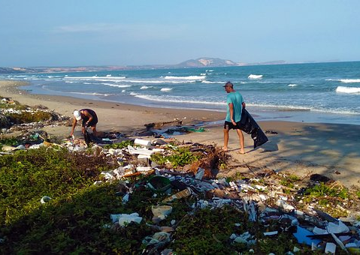
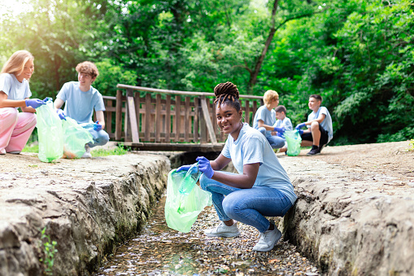
TAKE PART IN BEACH CLEANS AND LITTER PICKS
solutions
See our ‘How to Organise a Beach Clean’ How To Guide for more information.
Look for other projects
Volunteer, support, research, and spread the messages of conservation charities and organisations
Notes:
Lastly but not least, find yourself a local beach clean-up or local litter pick. They happen up and down the country and can be a great day out, a chance to meet new people whilst also making a difference. Imagine if every person took part in a beach clean just once a month, the amount of plastic entering our oceans would reduce dramatically! In fact, if every single person just picked up just 1 piece of litter per day, we would save 24 billion pieces of litter entering the environment every year!

Slide 22
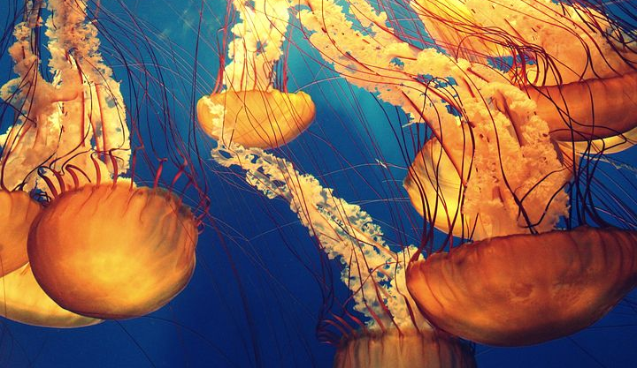
Ocean WARMING
OCEAN WARMING
Rate of warming has doubled in 20 years
Impacts life in sea and land
Notes:
We know that the oceans are warming, in fact ocean warming has doubled since 1993 and is now 0.65 degrees warmer than preindustrial levels. Although this may not seem like much, it has great impacts on the oceans and the life that lives in them. The oceans have a very delicate balance within a very precise set of circumstances. If anything changes, it creates a knock-on effect for all the sea life and plant life, and ultimately our whole world.

Slide 23
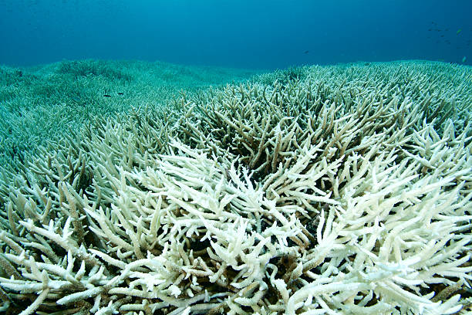
Ocean
WARMING
CORAL BLEACHING
What is coral bleaching?
We will discuss the issues around this phenomenon in the next few slides
Why do coral reefs matter?
Coral reefs help to sustain 25% of all life under the sea
How does that impact the world
Entire communities of fish can become vulnerable and that affects the health of the ocean…
Notes:
One of the main problems with a rise in sea temperatures is what is known as coral bleaching. This section will discuss coral bleaching in more depth so you can understand what it is.
Why care for coral reefs? Well our coral reefs help to sustain around 25% of all sea life in the oceans, meaning they are vital for a large section of the life to survive. Coral bleaching damages these reefs. If these reefs are damaged these impacts entire communities of fish, which then impacts on the health of the entire ocean around them.

Slide 24
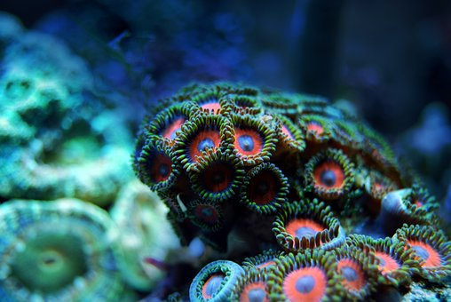
CORAL BLEACHING: WHAT ARE CORALS?
Ocean
WARMING
Corals are living creatures
Algae gives corals their bright colours through photosynthesis
They are made of polyps
Polyps house algae
Corals rely on algae to survive
Notes:
Let’s get back to basics. What are corals? Corals are living creatures. They are made up of thousands of tiny animals called polyps, which each have algae living inside them. The polyps and the algae have what is known as a symbiotic relationship, meaning that they both benefit. The polyps provide the algae with nutrients, and in turn the algae provide the polyps with sugars produced during photosynthesis, which are responsible for their bright colours.

Slide 25


CORAL BLEACHING:
HOW CORALS ARE AFFECTED
Ocean
WARMING
Fish can no longer use corals for food or nurseries and many fish communities suffer
When seas get warmer the corals get shocked and expel their algae
The corals become vulnerable to disease and often die
The corals then start to starve as it needs the algae to survive
The corals lose their colour and turn white
Notes:
When the oceans get warmer, the corals receive a shock. They then expel their algae. The coral starts to starve as it no longer have the sugars provided by the algae they need to survive. The corals then lose their colour and start to appear white. This is why the process is called a bleaching event as the colour is bleached out of them. The corals then become vulnerable to disease and often die as a result. This means that they are no longer useful for the fish and many communities die as they no longer have homes to live in; food to eat; or nurseries for their young.
In these pictures you can see a healthy coral reef with colourful corals and many varieties of fish swimming amongst them. In contrast on the next picture you can see the white coral is already dead and there is no life living amongst these corals.

Slide 26




Ocean
WARMING
BIGGER PICTURE:
THE GREAT BARRIER REEF
vulnerable
Lost half its live coral in 20 years
136 endangered species in GBR
4 out 6
Species endangered
4 Mass bleaching events in last 7 years
vulnerable
Notes:
Let’s look at one of the most famous coral reefs on our planet, the Great Barrier Reef in Australia. The Great Barrier Reef has lost half of its live corals in only the last 20 years. This is really concerning as the Great Barrier Reef supports at least 12,000 species, and 136 known endangered species. These species will die out if coral bleaching continues. As well as numerous fish, invertebrates and other sea life, many larger marine mammals are endangered or vulnerable because of coral bleaching in the great Barrier Reef region.
These mammals rely on coral reefs for foraging, providing safe havens from predators and providing fish for food. If the coral reefs continue to decline, the fish species continue to decline and the number of these larger mammals continue to decline.
If these bleaching events continue to happen the health of our entire oceans will be at risk, and therefore our lives will be at risk too. But as always, we are here to show you some incredible things that are happening to save the oceans and repair these places.

Slide 27


Coral reef restoration success story
Notes:
Amazingly these coral reef systems can be replanted. Just as we might plant a forest, we can also re-plant a coral reef. Restoration projects use artificial skeletal structures made of metal to place in the ocean with young corals attached helping to repopulate coral communities within the ocean. Take a look at this short video which shows the impact that these projects can have. Show video: https://www.azocleantech.com/article.aspx?ArticleID=1433

Slide 28
Solutions
TOGETHER WE CAN fix our future
CONSUME : Be a conscious consumer
EDUCATE : Learn more about the topic
Do : Be Proactive. Get involved.
DISCUSS: Share knowledge with friends and family
Notes:
As always, our Power Of Ten Solutions provide tangible actions that you can all take to contribute to the restoration of our planet. Here are just a few examples of organisations that you can follow. Follow these projects on social media, when you are on holiday, research local reef restoration projects and tell others about the amazing work that can be done, or just spread the word.

Slide 29



SUPPORT CORAL REEF RESTORATIONS
solutions
Look for other projects
Volunteer, support, research, and spread the messages of conservation charities and organisations
Notes:
CONSUME : Having discussed the importance of avoiding single use plastics, it is so important to ensure that you are not contributing too much to this problem. On average a plastic bag is used for 12 minutes and then discarded. If everybody used reusables instead then the demand for these bags would decrease and our reliance on them therefore would begin to decrease.
Let’s look at an example, in America the average amount of plastic bags used per person per year is 365… In Denmark however, this is 4 plastic bags per year… imagine if all countries only used 4 plastic bags per year, we would have a very different situation… If people have the alternatives, if they are prepared then, we can turn the tide on our plastic demand.
But we all forget – so if you have forgotten your reusable, simply ask if they have a non-plastic option – like a paper bag, or paper straw, these items have a significantly reduced impact on our resources, our wildlife and ultimately on us.
Other plastic items in the house can also be switched out for non-plastic options, next time you go shopping and the first item you see is plastic, search a bit more and try and find its non-plastic alternative – there is ALWAYS a non-plastic alternative!
Other plastic items in the house can also be switched out for non-plastic options, next time you go shopping and the first item you see is plastic, search a bit more and try and find it’s non-plastic alternative – there is ALWAYS a non-plastic alternative!

Slide 30




REDUCE YOUR CARBON FOOTPRINT
solutions
Use a tool to track your personal carbon contribution.
DOWNLOAD AN APP
There are numerous apps. Choose one based on data, lifestyle, or gaming interface.
Choose an online tool
This WWF one helps you to check which activities are most harmful and gives realistic goals.
Notes:
Everybody can help reduce the impact of rising sea temperatures by assessing and reducing our own personal carbon footprints. There are numerous tools out there to help you to understand the actions that have the most impacts – choose an App or use this WWF tool. You can find one that suits your own style even one that has a gaming interface.

Slide 31


Choose reef-friendly products
solutions
Follow our sustainable shopping guidelines.
Select options without
Oxybenzone
and Octinoxate
Notes:
One way you can help avert these disasters is to think consciously when buying your products. Always choose your products with the lowest impact on the planet. That means ideally choosing products that are locally sourced – to avoid emissions from flying, choose non plastic options and think about the sustainability values behind the company you are purchasing from. You can check out our sustainable shopping guidelines downloadable from Power Of Ten Platform.

Slide 32



Watch documentaries with others
solutions
LEARN MORE ABOUT THE TOPIC
When we learn more,
we care more.
Spread the word and
educate share movie nights with friends and family
Notes:
As always, watch documentaries, and share these with friends and family. By doing this you will help to get more people engaged in the issues and solutions to these problems. These are just few great documentaries.

Slide 33

OVERFISHING
OVERFISHING
There are no longer plenty more fish in the sea
Our methods are causing devastating impacts
Notes:
The last impact that we are going to discuss is overfishing in our oceans. Many people think of the ocean as a never-ending resource and that “there are plenty of fish in the sea” however as we will learn, we are having more of an impact on the oceans than they can deal with and it’s time we realised the errors of our ways.

Slide 34

OVERFISHING
OVERFISHING
Our relationship with the sea
Humanity has thrived in coastal areas. 3.3 billion people rely on the ocean for their source of food.
Increasing pressure
As our population increases across the world, so does our impact on the ocean
How does that impact the world
Our current industrial fishing methods are threatening the delicate balance of ocean life
Notes:
People have always fished in the ocean, it’s one of the ways that humanity has thrived and have become so successful. Just think how many major cities are built next to the sea. In fact 3.3 billion people (nearly half of the world’s population) rely on the ocean for one of their main sources of food.
However, with the human population increasing drastically, as does our impact on the sea. As we have progressed as a species, so has our efficiency at gathering what we
need. Our current fishing practices, to satisfy the growing demand for fish, are seriously damaging our oceans.

Slide 35




OVERFISHING
TRADITIONAL FISHING TECHNIQUES
.
Notes:
Across the world traditional fishing methods are still used by many communities. These are methods that have been passed down through generations. They are sustainable ways of fishing. This means that they respect the oceans, only catch what is needed and leave enough fish in the oceans to replace those they have caught.
These images show how different cultures and communities across the world catch their fish using ancient methods.
QUESTION: Do you think this is how your fish in your fish and chips is caught?....

Slide 36



OVERFISHING
INDUSTRIAL FISHING:
DESTRUCTION OF THE SEAS
.
VIDEO OF TRAWL FISHING
80% of fish are overexploited
An Estimated 40% of fish caught are not the target species
Notes:
Unfortunately, the fish in your fish and chips, either from a supermarket or the local fish and chip shop, was most likely caught using industrial fishing methods. These are how the majority of popular fish such as cod and haddock are caught. 70% of fish landed in the UK are caught by industrial-sized ships.
So, what are modern industrial fishing methods?
Industrial fishing methods use a variety of techniques but they all are often done on a massive scale, using huge nets that sweep across the ocean floor, or through the ocean itself, capturing anything in its way. Of course many other species get caught in the nets – they struggle to get free and often are dead by the time the boat pulls the net up. As they are not what the fishermen were looking for, they will then just toss these by-catches overboard. These animals have died unnecessarily. As this is happening across the world, the balance of sea life within the oceans is being disturbed, further upsetting the delicate ecosystems that exist to sustain all life. SHOW VIDEO – TRAWL FISHING
As you can see in these pictures many species get caught up in these nets, in fact an estimated 40% of fish caught are not the target species. If you buy shrimp – there have been known to be twice the amount of by-catches as shrimp themselves.
Although these practices are banned in EU waters, illegal fishing takes place on a huge scale and it is notoriously difficult to patrol and control fishing practices.

Slide 37
Solutions
TOGETHER WE CAN fix our future
CONSUME : Be a conscious consumer
EDUCATE : Learn more about the topic
Do : Be Proactive. Get involved.
DISCUSS: Share knowledge with friends and family
Notes:
It is difficult to stop these practices from taking place, but there are organisations around the globe that are attempting to tackle this massive problem. Of course, for the oceans, it would be best if everyone stopped eating fish altogether. However, that is simply not going to happen. By reducing the amount of fish you eat or by choosing a less impactful fish to eat, you are doing your bit to stop the destruction of the seas. If everyone demands that these practices are stopped or stops buying fish that are caught in these ways then the market will react, but we must demand the change before it happens. The issues with our ocean may seem massive, but as we have seen, there are so many impactful ways we can make change as individuals and communities. The power of collective action is enormous, but it starts with all of us deciding to take matters into our own hands and to speak out on behalf of nature.

Slide 38





REDUCE YOUR FISH INTAKE
solutions
You don’t need to give up fish, but reducing intake and choosing consciously is a good place to start!
If you have to eat fish, choose farmed shellfish
Go fish free once a week
Use the MSC Good Fish Guide
Always ask where your fish has come from
Be aware of greenwashing
Notes:
We want to leave you with some inspirational projects that are taking place across the planet to help protect our oceans. The problems are big and can sometimes feel overwhelming, but if you know that you are being a part of the solution and not the problem then you are tackling it head on. Our Power Of Ten Solutions aim to help you make informed decisions at every step of the way. If you are already doing these things, that is fantastic

Slide 39

www. Powerof10.world
THANK YOU !
Together we
Can fix our future
Notes:
We hope that by seeing this presentation you are inspired to make sustainable choices in your lives that suit your own lifestyles. Please see our Power of Ten platform for more inspirational resources on how to help you live a life that is kinder to the planet and on how to spread these messages to others. We have plenty more topic-based resources to help you learn more too.
We hope to see you on the Power of Ten platform, just search Power of Ten to find out more or visit Powerof10.world.

Slide 40
THANK YOU !

